Slide 1
Introduction

Slide 2
Information
Lecturer: Vesselin Evgueniev Gueorguiev
  room: 2300A
  e-mail: veg@tu-sofia.bg
    Subject: FDIBA student
Course materials:
  url: http://pct.tu-sofia.bg/moodle001/course/category.php?id=59
    Username: student
    Password: pktt
Exam
  Duration: 3 hours
  Type of exam:
    Test with 60 questions: single choice, multiple choice, re-ordering, arrange in groups, missing link in diagrams, select and connect, etc.

Slide 3
Readings
Textbooks:
  P. van Roy, S. Haridi, “Concepts, Techniques, and Models of Computer Programming”
  R. W. Sebesta, “Concepts of Programming Languages,” 10th edition
  K. C. Louden, K. A. Lambert, “Programming Languages: Principles and Practice”, 3rd Edition
Additional readings:
  All books and papers about …

Slide 4
Computer? What is this?

Slide 5
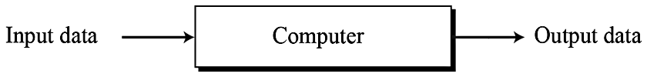
Data processors
Let us define a computer as a data processor.
  Using this definition, a computer acts as a black box that accepts input data, processes the data, and creates output data.
  Although this model can define the functionality of a computer today, it is too general.
    In this model, a pocket calculator is also a computer (which it is, in a literal sense).

Slide 6
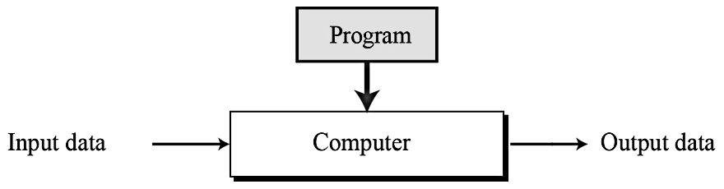
Programmable data processors
The Turing model is a better model for a general-purpose computer.
  This model adds an extra element to the specific computing machine: the program.
  A program is a set of instructions that tells the computer what to do with data.

Slide 7
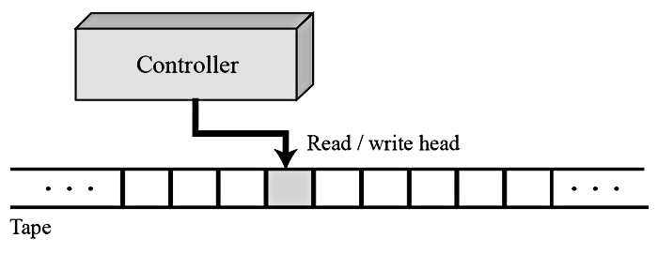
Turing machine
The idea of a universal computational device was first described by Alan Turing in 1937.
    He proposed that all computation could be performed by a special kind of a machine, now called a Turing machine.
    He based the model on the actions that people perform when involved in computation.
    He abstracted these actions into a model for a computational machine that has really changed the world.
  A Turing machine is made of three components: a tape, a controller and a read/write head

Slide 8

Turing machine components
Tape
  Although modern computers use a random-access storage device with finite capacity, we assume that the Turing machine’s memory is infinite.
  The tape, at any one time, holds a sequence of characters from the set of characters accepted by the machine.
  For our purpose, we assume that the machine can accept only two symbols: a blank (b) and digit 1.

Slide 9
Turing machine components
Read/write head
  The read/write head at any moment points to one symbol on the tape.
    We call this symbol the current symbol.
  The read/write head reads and writes one symbol at a time from the tape.
    After reading and writing, it moves to the left or to the right.
  Reading, writing and moving are all done under instructions from the controller.

Slide 10
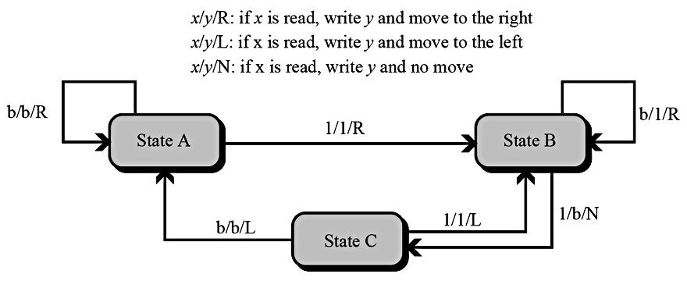
Turing machine components
Controller
  The controller is the theoretical counterpart of the central processing unit (CPU) in modern computers.
    It is a finite state automaton, a machine that has a predetermined finite number of states and moves from one state to another based on the input.
Transition state diagram for the Turing machine

Slide 11
Universal Turing machine
A universal Turing machine, a machine that can do any computation if the appropriate program is provided, was the first description of a modern computer.
  It can be proved that a very powerful computer and a universal Turing machine can compute the same thing.
  We need only provide the data and the program – the description of how to do the computation – to either machine.
In fact, a universal Turing machine is capable of computing anything that is computable.

Slide 12
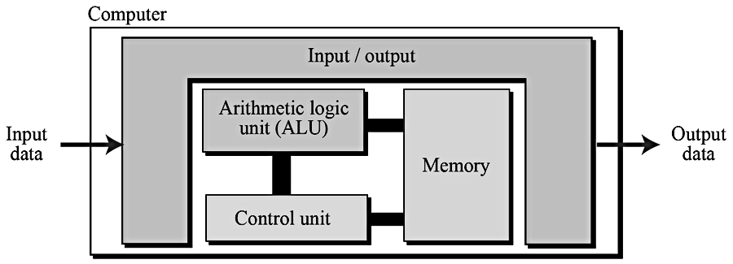
von NEUMANN model
Computers built on the Turing universal machine store data in their memory.
Around 1944–1945, John von Neumann proposed that, since program and data are logically the same, programs should also be stored in the memory of a computer.
  Four subsystems: memory, arithmetic logic unit, control unit, and input/output.

Slide 13
The stored program concept
The von Neumann model states that the program must be stored in memory.
  This is totally different from the architecture of early computers in which only the data was stored in memory: the programs for their task was implemented by manipulating a set of switches or by changing the wiring system.
The memory of modern computers hosts both a program and its corresponding data.
  This implies that both the data and programs should have the same format, because they are stored in memory.
  In fact, they are stored as binary patterns in memory – a sequence of 0s and 1s.

Slide 14
Sequential execution of instructions
A program in the von Neumann model is made of a finite number of instructions.
  In this model, the control unit fetches one instruction from memory, decodes it, then executes it.
    In other words, the instructions are executed one after another.
  Of course, one instruction may request the control unit to jump to some previous or following instruction, but this does not mean that the instructions are not executed sequentially.
Sequential execution of a program was the initial requirement of a computer based on the von Neumann model.
  Today’s computers execute programs in the order that is the most efficient.

Slide 15
Computers & Data

Slide 16
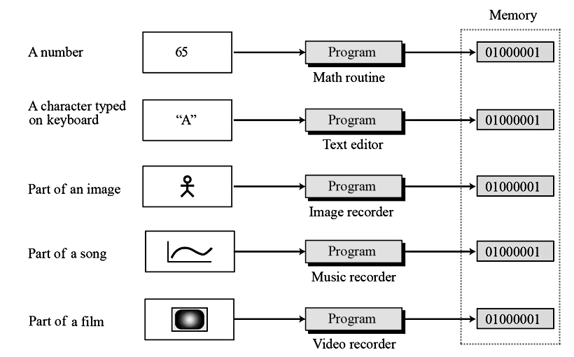
Storing data
Data today comes in different forms including numbers, text, audio, image and video.

Slide 17
Storing numbers
A number is changed to the binary system before being stored in the computer memory.
However, there are still two issues that need to be handled:
  How to store the sign of the number.
  How to show the decimal point.

Slide 18
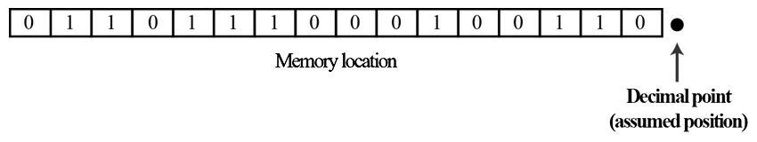
Storing integers
Integers are whole numbers (numbers without a fractional part).
  For example, 134 and −125 are integers, whereas 134.23 and −0.235 are not.
An integer can be thought of as a number in which the position of the decimal point is fixed: the decimal point is to the right of the least significant (rightmost) bit.
  For this reason, fixed-point representation is used to store an integer.
    In this representation the decimal point is assumed but not stored

Slide 19
Unsigned representation
An unsigned integer is an integer that can never be negative and can take only 0 or positive values.
  Its range is between 0 and positive infinity.
An input device stores an unsigned integer using the following steps:
  The integer is changed to binary.
  If the number of bits is less than n, 0s are added to the left.

Slide 20
Sign-and-magnitude representation
In this method, the available range for unsigned integers (0 to 2^{n} − 1) is divided into two equal sub-ranges.
  The first half represents positive integers, the second half, negative integers.
  In sign-and-magnitude representation, the leftmost bit defines the sign of the integer.
    If it is 0, the integer is positive.
    If it is 1, the integer is negative.

Slide 21

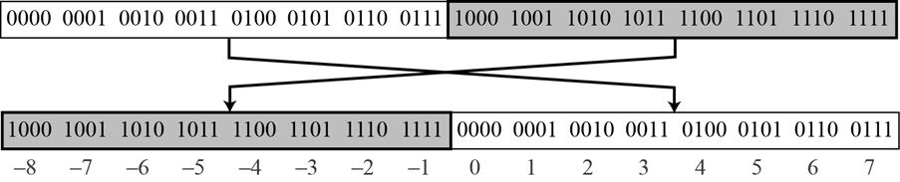
Integer data
    One’s complementing:
  This operation simply reverses (flips) each bit. A 0-bit is changed to a 1-bit, a 1-bit is changed to a 0-bit.
Two’s complement integers
  Almost all computers use two’s complement representation to store a signed integer in an n-bit memory location.
    In this method, the available range for an unsigned integer of (0 to 2n − 1) is divided into two equal sub-ranges.
Notes:
One’s complementing or taking the one’s complement of an integer: The operation can be applied to any integer, positive or negative
Two’s complementing
The first sub-range is used to represent nonnegative integers, the second half to represent negative integers.
The bit patterns are then assigned to negative and nonnegative (zero and positive) integers
In two’s complement representation, the leftmost bit defines the sign of the integer: 0 -> positive; 1 -> negative.

Slide 22
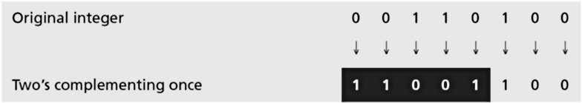
Integer data
How calculate two’s complement integers ?
  Method 1: First, we take the one’s complement and then add 1 to the result.
  Method 2: First, we copy bits from the right until a 1 is copied; then, we flip the rest of the bits.

Slide 23
Storing reals
A real is a number with an integral part and a fractional part.
  Example: 14.3 is a real number – the integral part is 14 and the fractional part is 3/10.
  Real numbers with very large integral parts or very small fractional parts should not be stored in fixed-point representation
    Although a fixed-point representation can be used to represent a real number, the result may not be accurate or it may not have the required precision.
    Example 1: We use a fixed-point representation with two digits at the right of the decimal point and fourteen digits at the left of the decimal point, for a total of sixteen digits (in the decimal system). The precision of a real number in this system is lost if we try to represent a decimal number such as 1.00234 because the system stores the number as 1.00.

Slide 24
Storing reals
A real is a number with an integral part and a fractional part.
  Example: 14.3 is a real number – the integral part is 14 and the fractional part is 3/10.
  Real numbers with very large integral parts or very small fractional parts should not be stored in fixed-point representation
    Although a fixed-point representation can be used to represent a real number, the result may not be accurate or it may not have the required precision.
    Example 2: We use a fixed-point representation with six digits to the right of the decimal point and ten digits for the left of the decimal point, for a total of sixteen digits (In the decimal system). The accuracy of a real number in this system is lost if we try to represent a decimal number such as 236154302345.00. The system stores the number as 6154302345.00 because the integral part is much smaller than it should be.

Slide 25
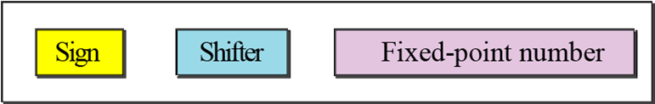
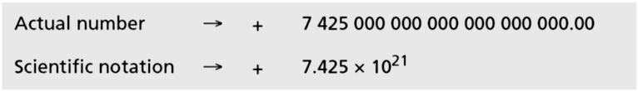
Floating-point representation
The solution for maintaining accuracy or precision is to use floating-point representation.
  A floating point representation of a number is made up of three parts: a sign, a shifter and a fixed-point number.
  Example (decimal numbers):
sign
Fixed-point part
shifter

Slide 26
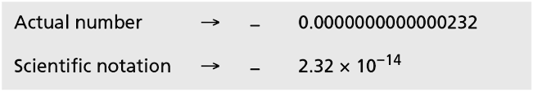
Floating-point representation
The solution for maintaining accuracy or precision is to use floating-point representation.
  A floating point representation of a number is made up of three parts: a sign, a shifter and a fixed-point number.
  Example (decimal numbers):

Slide 27
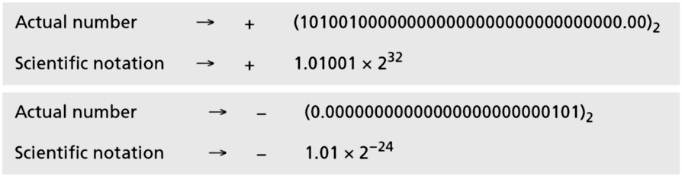
Floating-point representation
The solution for maintaining accuracy or precision is to use floating-point representation.
  A floating point representation of a number is made up of three parts: a sign, a shifter and a fixed-point number.
  Example (binary numbers):

Slide 28
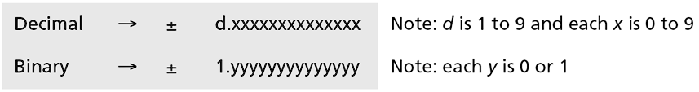
Normalization
To make the fixed part of the representation uniform, both the scientific method (for the decimal system) and the floating-point method (for the binary system) use only one non-zero digit on the left of the decimal point.
  This is called normalization.
  In the decimal system this digit can be 1 to 9, while in the binary system it can only be 1. In the following, d is a non-zero digit, x is a digit, and y is either 0 or 1.

Slide 29
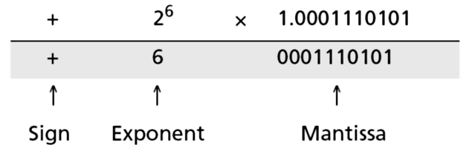
Normalization
Note that the point and the bit 1 to the left of the fixed-point section are not stored—they are implicit.
  The mantissa is a fractional part that, together with the sign, is treated like an integer stored in sign-and-magnitude representation.

Slide 30
Excess System
The exponent, the power that shows how many bits the decimal point should be moved to the left or right, is a signed number.
  Although this could have been stored using two’s complement representation, a new representation, called the Excess system, is used instead.
In the Excess system, both positive and negative integers are stored as unsigned integers.
  To represent a positive or negative integer, a positive integer (called a bias) is added to each number to shift them uniformly to the non-negative side.
  The value of this bias is 2^{m−1} − 1, where m is the size of the memory location to store the exponent

Slide 31
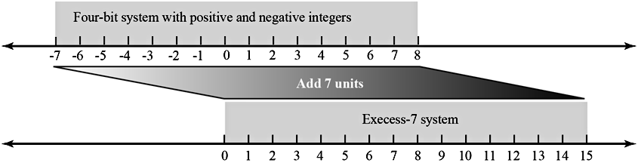
Excess System
Example:
  We can express sixteen integers in a number system with 4-bit allocation. By adding seven units to each integer in this range, we can uniformly translate all integers to the right and make all of them positive without changing the relative position of the integers with respect to each other, as shown in the figure. The new system is referred to as Excess-7, or biased representation with biasing value of 7.

Slide 32


IEEE Standard
Single precision (Excess_127)
Double precision (Excess_1023)

Slide 33

IEEE Standard
Example: Show the Excess_127 (single precision) representation of the decimal number –161.875.
  The sign is negative, so S = 1.
  Decimal to binary transformation: 161.875= (10100001.111)₂.
  Normalization: (10100001.111)₂ = (1.0100001111)₂ × 27.
  E = 7 + 127 = 134 = (10000110)₂ and M = (0100001111)₂.
  Representation:
  The number is stored in the computer as
  11000011010000111100000000000000

Slide 34
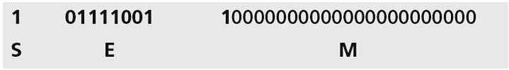
IEEE Standard
Example: Show the Excess_127 (single precision) representation of the decimal number –0.0234375.
  The sign is negative, so S = 1.
  Decimal to binary transformation: 0.0234375 = (0.0000011)₂.
  Normalization: (0.0000011)₂ = (1.1)₂ × 2⁻⁶.
  E = –6 + 127 = 121 = (01111001)₂ and M = (1)₂.
  Representation:
  The number is stored in the computer as
  10111100110000000000000000000000

Slide 35

IEEE Standard
Example: The bit pattern (11001010000000000111000100001111)₂ is stored in Excess_127 format. Show the value in decimal.
  Sign, Exponent, Mantissa
  The sign is negative.
  The shifter = E − 127 = 148 − 127 = 21.
  This gives us (1.00000000111000100001111)2 × 221.
  The binary number is (1000000001110001000011.11)2.
  The absolute value is 2104378.75.
  The number is −2104378.75.

Slide 36
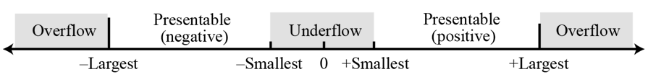
Overflow and Underflow
Overflow and underflow
  –Largest = -(1 - 2⁻²⁴) × 2⁺¹²⁸
  +Largest = +(1 - 2⁻²⁴) × 2⁺¹²⁸
  –Smallest = -(1 - 2⁻¹) × 2⁻¹²⁷
  +Largest = +(1 - 2⁻¹) × 2⁻¹²⁷
Storing Zero
  A real number with an integral part and the fractional part set to zero (0.0), cannot be stored using the steps discussed above.
    To handle this special case, it is agreed that in this case the sign, exponent and the mantissa are set to 0s.

Slide 37
Storing text
A section of text in any language is a sequence of symbols used to represent an idea in that language.
  For example, the English language uses 26 symbols (A, B, C,…, Z) to represent uppercase letters, 26 symbols (a, b, c, …, z) to represent lowercase letters, nine symbols (0, 1, 2, …, 9) to represent numeric characters and symbols (., ?, :, ; , …, !) to represent punctuation.
  Other symbols such as blank, newline, and tab are used for text alignment and readability.
  We can represent each symbol with a bit pattern.
Codes
  ASCII
  Unicode
  Other Codes

Slide 38
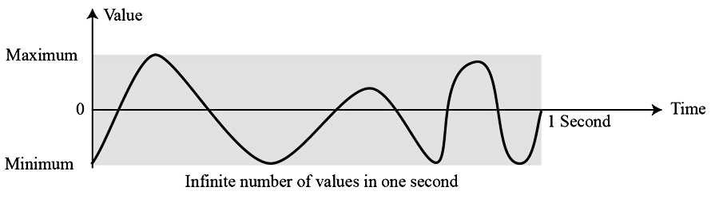
Storing audio
Audio is a representation of sound or music.
  Audio, by nature, is different to the numbers or text.
    Text is composed of countable entities (characters): we can count the number of characters in text.
    Text is an example of digital data.
  Audio is not countable.
  Audio is an example of analog data.
    Even if we are able to measure all its values in a period of time, we cannot store these in the computer’s memory, as we would need an infinite number of memory locations.

Slide 39
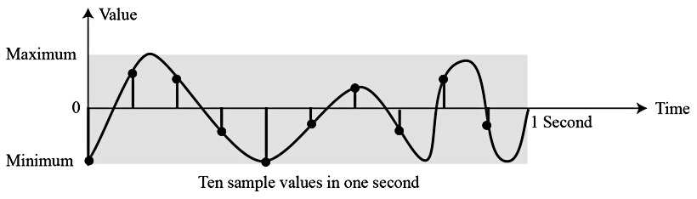
Sampling
If we cannot record all the values of a an audio signal over an interval, we can record some of them.
  Sampling means that we select only a finite number of points on the analog signal, measure their values, and record them.

Slide 40
Quantization
The value measured for each sample is a real number.
  This means that we can store 40,000 real values for each one second sample.
  However, it is simpler to use an unsigned integer (a bit pattern) for each sample.
Quantization refers to a process that rounds the value of a sample to the closest integer value.
  For example, if the real value is 17.2, it can be rounded down to 17: if the value is 17.7, it can be rounded up to 18.

Slide 41
Encoding
The quantized sample values need to be encoded as bit patterns.
  Some systems assign positive and negative values to samples, some just shift the curve to the positive part and assign only positive values.
If we call the bit depth or number of bits per sample B, the number of samples per second, S, we need to store S × B bits for each second of audio.
  This product is sometimes referred to as bit rate, R.
    For example, if we use 40,000 samples per second and 16 bits per each sample, the bit rate is R = 40,000 × 16 = 640,000 bits per second

Slide 42
Storing images
Images are stored in computers using two different techniques: raster graphics and vector graphics.
Raster graphics (or bitmap graphics) is used when we need to store an analog image such as a photograph.
  A photograph consists of analog data, similar to audio information.
  The difference is that the intensity (color) of data varies in space instead of in time.
    This means that data must be sampled.
    However, sampling in this case is normally called scanning.
    The samples are called pixels (picture elements).

Slide 43
Raster graphics
Raster graphics has two disadvantages:
  The file size is big and rescaling is troublesome.
    To enlarge a raster graphics image means enlarging the pixels, so the image looks ragged when it is enlarged.
Resolution
  Just like audio sampling, in image scanning we need to decide how many pixels we should record for each square or linear inch.
  The scanning rate in image processing is called resolution.
    If the resolution is sufficiently high, the human eye cannot recognize the discontinuity in reproduced images.

Slide 44
Raster graphics
Color depth
  The number of bits used to represent a pixel, its color depth, depends on how the pixel’s color is handled by different encoding techniques.
  The perception of color is how our eyes respond to a beam of light.
  Our eyes have different types of photoreceptor cells: some respond to the three primary colors red, green and blue (often called RGB), while others merely respond to the intensity of light.
True colors
  One of the techniques used to encode a pixel is called True-Color, which uses 24 bits to encode a pixel.
Indexed color
  The indexed color (or palette color) scheme uses only a portion of these colors

Slide 45
Vector graphics
The vector graphic image encoding method, however, does not store the bit patterns for each pixel.
  An image is decomposed into a combination of geometrical shapes such as lines, squares or circles.
  For example, consider a circle of radius r. The main pieces of information a program needs to draw this circle are:
    The radius r and equation of a circle.
    The location of the center point of the circle.
    The stroke line style and color.
    The fill style and color.

Slide 46
Storing video
Video is a representation of images (called frames) over time.
A movie consists of a series of frames shown one after another.
  In other words, video is the representation of information that changes in space and in time.
  So, if we know how to store an image inside a computer, we also know how to store video: each image or frame is transformed into a set of bit patterns and stored.
  The combination of the images then represents the video.

Slide 47
Operation On Data

Slide 48
Logical operations
Logic operations refer to those operations that apply the same basic operation on individual bits of a pattern, or on two corresponding bits in two patterns.
  This means that we can define logic operations at the bit level and at the pattern level.
  A logic operation at the pattern level is n logic operations, of the same type, at the bit level where n is the number of bits in the pattern.

Slide 49
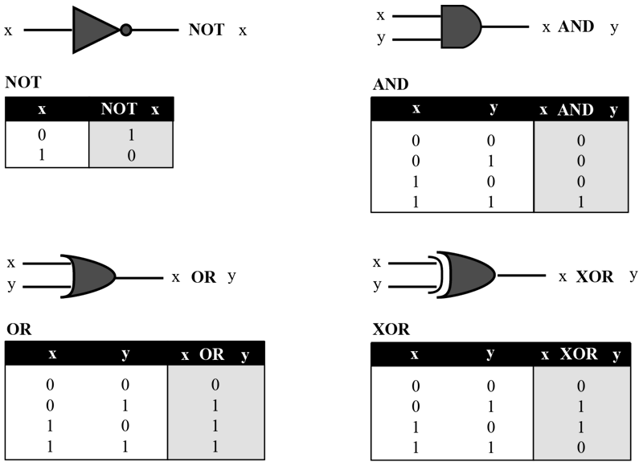
Logic operations at bit level
A bit can take one of the two values: 0 or 1.
  If we interpret 0 as the value false and 1 as the value true, we can apply the operations defined in Boolean algebra to manipulate bits.
Boolean algebra, named in honor of George Boole, belongs to a special field of mathematics called logic.
Main operations:

Slide 50
Logic operations at bit level
NOT
  The NOT operator is a unary operator: it takes only one input.
  The output bit is the complement of the input.
AND
  The AND operator is a binary operator: it takes two inputs.
  The output bit is 1 if both inputs are 1s and the output is 0 in the other three cases.
OR
  The OR operator is a binary operator: it takes two inputs.
  The output bit is 0 if both inputs are 0s and the output is 1 in other three cases.

Slide 51
Logic operations at bit level
XOR
  The XOR operator is a binary operator like the OR operator, with only one difference: the output is 0 if both inputs are 1s.
  In English we use the conjunction “or” sometimes to mean an inclusive-or, and sometimes to means an exclusive-or.
    The sentence “I would like to have a car or a house” uses “or” in the inclusive sense – I would like to have a car, a house or both.
    The sentence “Today is either Monday or Tuesday” uses “or” in the exclusive sense – today is either Monday or Tuesday, but it cannot be both.
  We can always simulate XOR operator using the other three operators. The following two expressions are equivalent
x XOR y ↔ [x AND (NOT y)] OR [(NOT x) AND y]

Slide 52
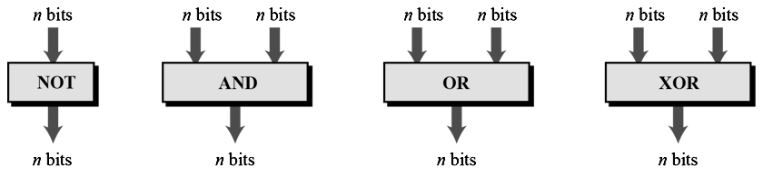
Logic operations at pattern level
The same four operators (NOT, AND, OR, and XOR) can be applied to an n-bit pattern.
  The effect is the same as applying each operator to each individual bit for NOT and to each corresponding pair of bits for the other three operators.

Slide 53
Applications
The four logic operations can be used to modify a bit pattern.
  Complementing (NOT)
  Unsetting (AND)
  Setting (OR)
  Flipping (XOR)

Slide 54
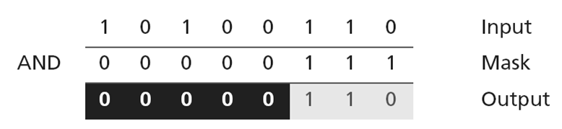
Applications
The four logic operations can be used to modify a bit pattern.
  Complementing (NOT)
  Unsetting (AND)
  Setting (OR)
  Flipping (XOR)
Example 1: Use a mask to unset (clear) the five leftmost bits of a pattern. Test the mask with the pattern 10100110.
  Solution: The mask is 00000111. The result of applying the mask is:

Slide 55
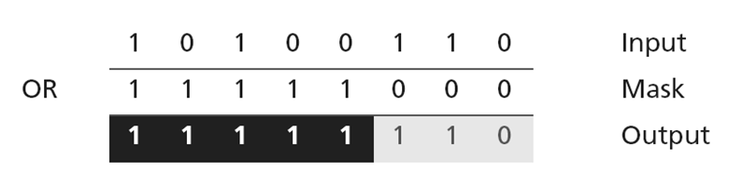
Applications
The four logic operations can be used to modify a bit pattern.
  Complementing (NOT)
  Unsetting (AND)
  Setting (OR)
  Flipping (XOR)
Example 2: Use a mask to set the five leftmost bits of a pattern. Test the mask with the pattern 10100110.
  Solution: The mask is 11111000. The result of applying the mask is:

Slide 56
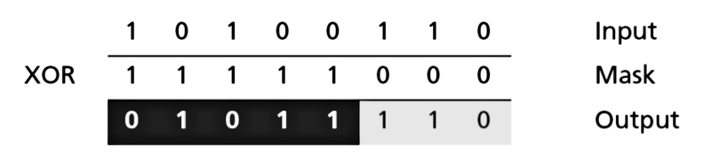
Applications
The four logic operations can be used to modify a bit pattern.
  Complementing (NOT)
  Unsetting (AND)
  Setting (OR)
  Flipping (XOR)
Example 3: Use a mask to flip the five leftmost bits of a pattern. Test the mask with the pattern 10100110.
  Solution: The mask is 11111000. The result of applying the mask is:

Slide 57
SHIFT operations
Shift operations move the bits in a pattern, changing the positions of the bits.
  They can move bits to the left or to the right.
We can divide shift operations into two categories: logical shift operations and arithmetic shift operations.

Slide 58
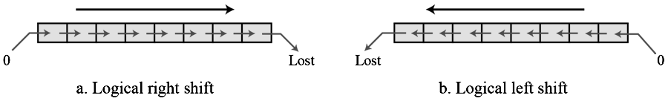
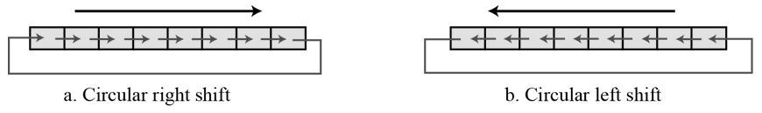
Logical shift operations
A logical shift operation is applied to a pattern that does not represent a signed number.
  The reason is that these shift operations may change the sign of the number that is defined by the leftmost bit in the pattern.
We distinguish two types of logical shift operations, as described below:
  Logical shift
  Logical circular shift (Rotate)

Slide 59
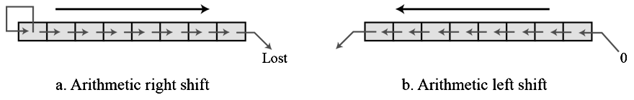
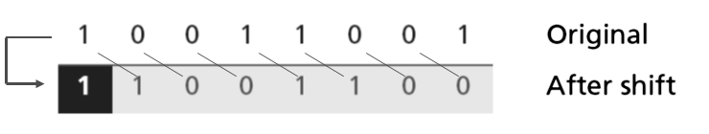
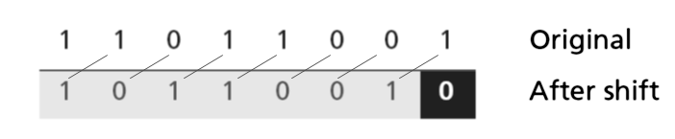
Arithmetic shift operations
Arithmetic shift operations assume that the bit pattern is a signed integer in two’s complement format.
Arithmetic right shift is used to divide an integer by two, while arithmetic left shift is used to multiply an integer by two.
Examples:

Slide 60
Arithmetic operations
Arithmetic operations involve adding, subtracting, multiplying and dividing.
  We can apply these operations to integers and floating-point numbers.
Arithmetic operations on integers
  All arithmetic operations such as addition, subtraction, multiplication and division can be applied to integers.
    Although multiplication (division) of integers can be implemented using repeated addition (subtraction), the procedure is not efficient.
    There are more efficient procedures for multiplication and division, such as Booth procedures, but these are beyond the scope of this course.
Notes:
There are more efficient procedures for multiplication and division, such as Booth procedures, but these are beyond the scope of this course.
For this reason, we only discuss addition and subtraction of integers here.

Slide 61
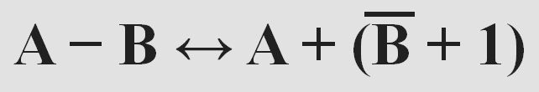
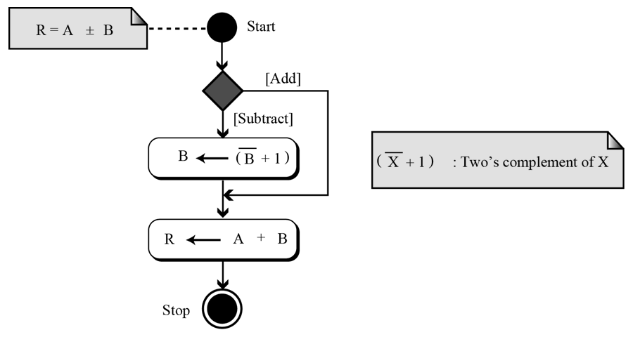
Arithmetic operations
Two’s complement integers
  When the subtraction operation is encountered, the computer simply changes it to an addition operation, but makes two’s complement of the second number:
  Algorithm:
Where B is the one’s complement of B and
(B + 1) means the two’s complement of B
Notes:
In two’s complement representation, the leftmost bit defines the sign of the integer: 0 -> positive; 1 -> negative.
When we do arithmetic operations on numbers in a computer, we should remember that each number and the result should be in the range defined by the bit allocation

Slide 62
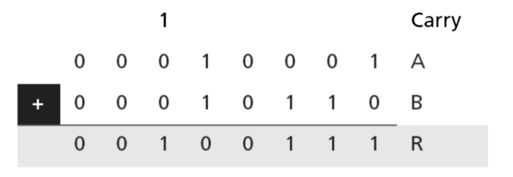
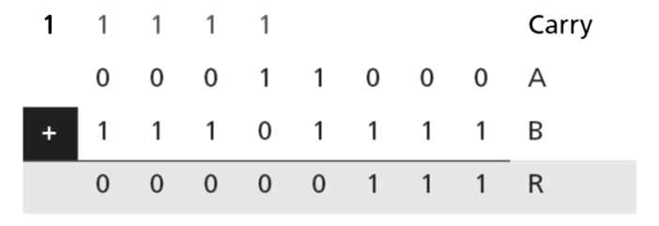
Arithmetic operations
Examples:
  Two integers A (+17) and B (+22) are stored in two’s complement format. The operation is adding. The result is stored in R (+39).
  Two integers A (+24) and B (-17) are stored in two’s complement format. The operation is adding. The result is stored in R (+7).
A = (00010001)₂ B = (00010110)₂
A = (00011000)₂ B = (11101111)₂

Slide 63
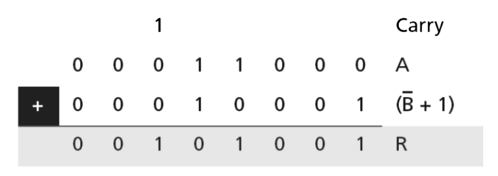
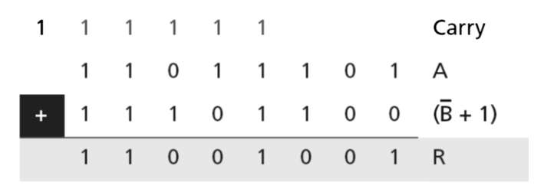
Arithmetic operations
Examples:
  Two integers A (+24) and B (-17) are stored in two’s complement format. The operation is subtracting. The result is stored in R (+41).
  Two integers A (-35) and B (+20) are stored in two’s complement format. The operation is subtracting. The result is stored in R (-55).
A = (00011000)₂ B = (11101111)₂
A = (11011101)₂ B = (00010100)₂

Slide 64
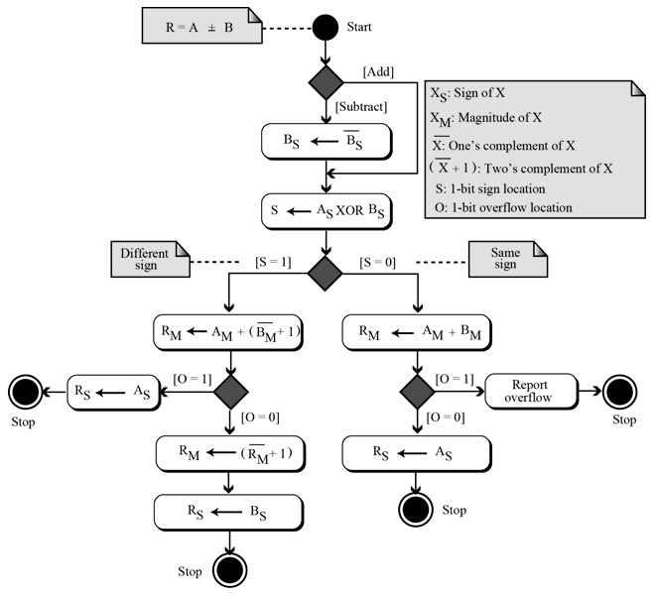
Sign-and-magnitude integers
Addition and subtraction for integers in sign-and-magnitude representation looks very complex.
We have four different combination of signs (two signs, each of two values) for addition and four different conditions for subtraction.
  This means that we need to consider eight different situations.
  However, if we first check the signs, we can reduce these cases.

Slide 65
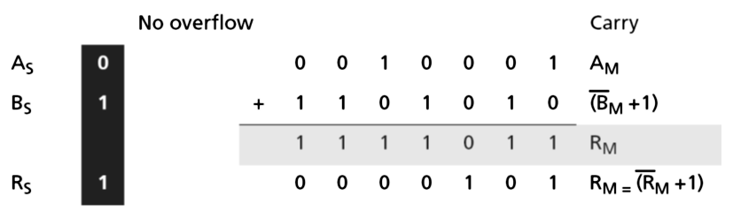
Sign-and-magnitude integers
Example:
  Two integers A (+17) and B (-25) are stored in sign-and-magnitude format. Show how B is added to A. The result is stored in R (-5).
    A = (0 0010001)₂ B = (1 0010110)₂
  Solution:
    The operation is adding: the sign of B is not changed.
    S = A_{S} XOR B_{S} = 1; R_{M} = A_{M} + (B_{M} +1). Since there is no overflow, we need to take the two’s complement of R_{M}.
    The sign of R is the sign of B.

Slide 66
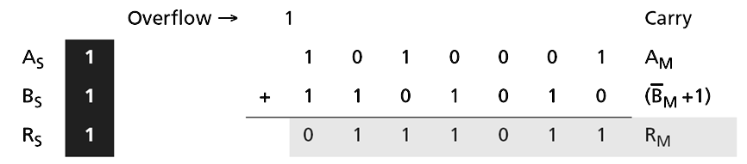
Sign-and-magnitude integers
Example:
  Two integers A (-81) and B (-22) are stored in sign-and-magnitude format. Show how B is subtracted from A. The result is stored in R.
    A = (1 1010001)₂ B = (1 0010110)₂
  Solution:
  The operation is subtracting: S_{B} = S_{B}.
  S = A_{S} XOR B_{S} = 1, R_{M} = A_{M} + (B_{M} +1). Since there is an overflow, the value of R_{M} is final. The sign of R is the sign of A.

Slide 67
Arithmetic operations on reals
All arithmetic operations such as addition, subtraction, multiplication and division can be applied to reals stored in floating-point format.
  Multiplication of two reals involves multiplication of two integers in sign-and-magnitude representation.
  Division of two reals involves division of two integers in sign-and-magnitude representations.
Notes:
Since we did not discuss the multiplication or division of integers in sign-and-magnitude representation, I will not discuss the multiplication and division of reals, and only show addition and subtractions for reals.

Slide 68
Addition and subtraction of reals
A real is a number with an integral part and a fractional part.
  For example, 23.7 is a real number – the integral part is 27 and the fractional part is 7/10.
  Although a fixed-point representation can be used to represent a real number, the result may not be accurate or it may not have the required precision.
Real numbers with very large integral parts or very small fractional parts should not be stored in fixed-point representation

Slide 69
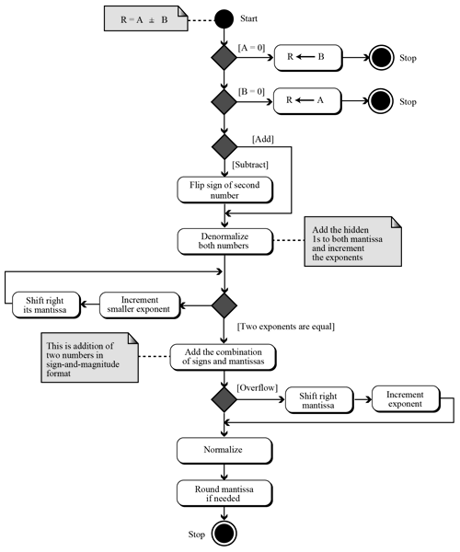
Addition and subtraction of reals
Addition and subtraction of real numbers stored in floating-point numbers is reduced to addition and subtraction of two integers stored in sign-and-magnitude (combination of sign and mantissa) after the alignment of decimal points.
    Simplified version of algorithm:
Notes:
The figure shows a simplified version of the procedure (there are some special cases that I have ignored)

Slide 70
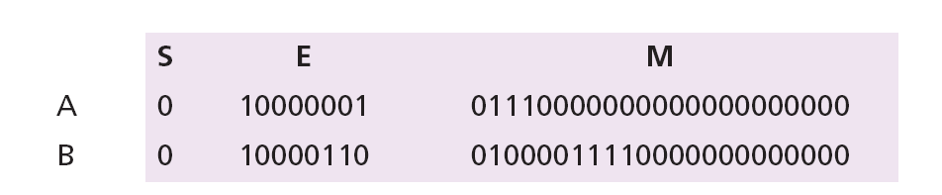
Addition and subtraction of reals
Example 1: Show how the computer finds the result of
(+5.75) + (+161.875) = (+167.625).
  These two numbers are stored in floating-point format and each number has a hidden 1 (which is not stored, but assumed).
  We de-normalize the numbers by adding the hidden 1s to the mantissa and incrementing the exponent.
    Now both de-normalized mantissas are 24 bits and include the hidden 1s.
    They should be stored in a location that can hold all 24 bits. Each exponent is incremented.

Slide 71
Addition and subtraction of reals
Example 1: Show how the computer finds the result of
(+5.75) + (+161.875) = (+167.625).
  Now we do sign-and-magnitude addition, treating the sign and the mantissa of each number as one integer stored in sign-and-magnitude representation.
  There is no overflow in the mantissa, so we normalize.
  The mantissa is only 23 bits, no rounding is needed.
    E = (10000110)₂ = 134 M = 0100111101. In other words, the result is (1.0100111101)₂ × 2¹³⁴⁻¹²⁷ = (10100111.101)₂ = 167.625.

Slide 72
Addition and subtraction of reals
Example 2: Show how the computer finds the result of
(+5.75) + (−7.0234375) = − 1.2734375.
  These two numbers can be stored in floating-point format:
  De-normalization results in:

Slide 73
Addition and subtraction of reals
Example 2: Show how the computer finds the result of
(+5.75) + (−7.0234375) = − 1.2734375.
  We apply addition operation on the combinations of sign and mantissa (the sign of the result is negative):
    Alignment is not needed (both exponents are the same)
  Now we need to normalize.
    We decrement the exponent three times and shift the de-normalized mantissa to the left three positions:

Slide 74
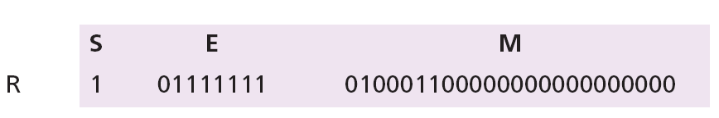
Addition and subtraction of reals
Example 2: Show how the computer finds the result of
(+5.75) + (−7.0234375) = − 1.2734375.
  The mantissa is now 24 bits, so we round it to 23 bits.
  The result is R = − 2¹²⁷⁻¹²⁷ × 1.0100011 = − 1.2734375.

Slide 75
Questions ?

