Slide 1
Introduction to Programming Paradigms
What is a “Programming Paradigm"?

Slide 2
Introduction
One approach to study computer programming is to study programming languages.
But there are a tremendously large number of languages, so large that it is impractical to study them all.
How can we tackle this immensity?
We could pick a small number of languages that are representative of different programming paradigms.
But this gives little insight into programming as a unified discipline.
We focus on programming concepts and the techniques to use them, not on programming languages.

Slide 3
Introduction
The concepts are organized in terms of computation models.
A computation model is a formal system that defines how computations are done.
There are many ways to define computation models.
It is important that the computation model should be directly useful to the programmer.
Each computation model has its own set of techniques for programming and reasoning about programs.
The number of different computation models that are known to be useful is much smaller than the number of programming languages.

Slide 4
Introduction
Computer science defines computation model in terms of concepts that are important to programmers: data types, operations, and a programming language.
The term ‘computation model’ makes precise the imprecise notion of ‘programming paradigm’.
Sometimes we will use the phrase programming model.
This refers to what the programmer needs: the programming techniques and design principles made possible by the computation model.

Slide 5
Introduction
Each computation model is based on a simple core language called its kernel language.
Computer science books introduce the kernel languages in a progressive way, by adding concepts one by one.
This lets to show the deep relationships between the different models.
Often, just adding one new concept makes a world of difference in programming.
When stepping from one model to the next, how do we decide on what concepts to add?
The main criterium is the creative extension principle.
Roughly, a new concept is added when programs become complicated for technical reasons unrelated to the problem being solved.
Adding a concept to the kernel language can keep programs simple, if the concept is chosen carefully.
Notes:
For example, adding destructive assignment (explicit state) to functional programming allows us to do object-oriented programming.

Slide 6
Software paradigms: #1 Myths
The Programmer can choose the "one true paradigm" for a project in isolation from other factors.
Reality: programming is now a social activity in which the "one true path" is a meaningless concept.
Religious wars:
Proponents of one paradigm often engage in holy wars.
Functional versus imperative programming.
Strong versus weak typing.
Speed versus robustness.
Memory models.
High-level versus low-level programming.
We must be careful not to descend into this pit.

Slide 7
Software paradigms: #1 Myth
The proper paradigm is not an absolute; it depends upon:
The social context of each paradigm
(technological) Footprint:
How many people use it?
Has it been used successfully in similar cases?
How many people know how to use it?
(software) Legacy:
What has been used before?
What lessons were learned?
What should we do differently?
Why should we do it differently?
(technological) Infrastructure:
What pre-existing resources are there?
What new resources are required?
How much will they cost?
Can we afford it?

Slide 8
Software paradigms: #2 Myth
“There is a programming paradigm appropriate to solve all programming problems.”
Reality: paradigms evolve in order to address specific cases, not the general case.
Programmers do not survive by "being the fittest"; they survive by "fitting in" and by getting the job done.
Likewise, paradigms do not survive by "being the fittest“; they survive by fitting into the larger context of software development.
A basic and fundamental paradigm shift
From "survival of the fittest": the programmer is a self-sufficient island.
To "survival of those who fit": the programmer is a connected and active citizen of a culture.
Notes:
How to fit:
Share your expertise and experience.
View that sharing not as fact, but associal evidence.
Become an intelligent consumer of evidence.

Slide 9
Software paradigms: #3 Myth
“One should always choose the most recent paradigm; it will be the easiest to use. “
Reality: the choice is also based upon other factors, including frequency of adoption and social pressure.
"The Magic Show"
The internet is full of videos that claim that "you can become a <insert paradigm> programmer in 15 minutes.“
This makes good PR, but is incredibly misleading.
As long as you follow the steps, you will get the same result.
But if you deviate - in any respect - you are likely to accomplish nothing at all.
These videos are rituals.
So, rituals are useful only as long as all you need to write is a guestbook!

Slide 10
Software paradigms: #4 Myth
“If I have a great idea, I can become the next Bill Gates/Steve Jobs/...”
Reality: It is about as likely as winning the lottery.
If you have a great idea, you can rest assured that at least 1000 other people had the same idea.
The difference is whether you do something about it, and whether you're first to market with the innovation.
Notes:
We're all swimming in the same river.

Slide 11
Paradigm adoption
Social guidelines for paradigm adoption
Consider the downsides of adoption
There is nothing more difficult than swimming against a social river.
Consider success and failure stories as evidence, and not as truth.
Remember the differences between pattern and ritual.
Seek to function via chemistry rather than alchemy.
Use the law of the median to your advantage, rather than to your disadvantage.
Avoid superfluous divergence from the median use case.

Slide 12
What is programming?
Programming is the step between the system’s specification and a running program that implements it.
The step consists in designing the program’s architecture and abstractions and coding them into a programming language.
This is a broad view, perhaps broader than the usual connotation attached to the word programming.
It covers both programming “in the small” and “in the large”.
It covers both (language-independent) architectural issues and (language-dependent) coding issues.
It is based more on concepts and their use rather than on any one programming language.
Notes:
This general view is natural for teaching programming.
It allows to look at many issues in a way unbiased by limitations of any particular language or design methodology.
When used in a specific situation, the general view is adapted to the tools used, taking account their abilities and limitations.

Slide 13
What is programming?
Many authors define programming, as a general human activity, to mean the act of extending or changing a system’s functionality.
Programming is a widespread activity that is done both by non-specialists and specialists (computer programmers).
Programming as defined above has two essential parts: a technology and its scientific foundation.
The technology consists of tools, practical techniques, and standards, allowing us to do programming.
The science consists of a broad and deep theory with predictive power, allowing us to understand programming.
Notes:
Ideally, the science should explain the technology in a way that is as direct and useful as possible.

Slide 14
What is programming?
If either part is left out, we are no longer doing programming.
Without the technology, we are doing pure mathematics.
Without the science, we are doing a craft, i.e., we lack deep understanding.
Teaching programming correctly therefore means teaching both the technology (current tools) and the science (fundamental concepts).
Knowing the tools prepares the student for the present.
Knowing the concepts prepares the student for future developments.

Slide 15
Programming education approaches
How can we separate the languages’ fundamental concepts, which underlie their success, from their historical accidents?
Practical programming languages provide a rich set of abstractions and syntax.
They scale up to programs of millions of lines of code.
Four main approaches
Kernel language
Foundational calculus
Virtual machine
Multiparadigm language

Slide 16
Programming education approaches
Kernel language approach
In this approach, a practical language is translated into a kernel language that consists of a small number of programmer-significant elements.
The rich set of abstractions and syntax is encoded into the small kernel language.
This gives both programmer and student a clear insight into what the language does.
The kernel language has a simple formal semantics that allows reasoning about program correctness and complexity.
This gives a solid foundation to the programmer’s intuition and the programming techniques built on top of it.

Slide 17
Programming education approaches
Foundational calculus approach
A foundational calculus reduces programming to a minimal number of elements.
The elements are chosen to simplify mathematical analysis, not to aid programmer intuition.
This helps theoreticians, but is not particularly useful to practicing programmers.
Foundational calculi are useful for studying the fundamental properties and limits of programming a computer, not for writing or reasoning about general applications.
Examples: λ-calculus or π-calculus

Slide 18
Programming education approaches
Virtual machine approach
A virtual machine defines a language in terms of an implementation on an idealized machine.
A virtual machine gives a kind of operational semantics, with concepts that are close to hardware.
This is useful for designing computers, implementing languages, or doing simulations.
It is not useful for reasoning about programs and their abstractions.

Slide 19
Programming education approaches
Multiparadigm language approach
A multiparadigm language is a language that encompasses several programming paradigms.
The usefulness of a multiparadigm language depends on how well the different paradigms are integrated.
Examples:
Scheme is both functional and imperative.
Leda has elements that are functional, object-oriented, and logical.

Slide 20
Pedagogical approach
There are two complementary approaches to teaching programming as a rigorous discipline:
The computation-based approach presents programming as a way to define executions on machines.
The logic-based approach presents programming as a branch of mathematical logic.

Slide 21
Pedagogical approach
The computation-based approach presents programming as a way to define executions on machines.
It grounds the student’s intuition in the real world by means of actual executions on real systems.
This is especially effective with an interactive system: the student can create program fragments and immediately see what they do.
Reducing the time between thinking “what if” and seeing the result is an enormous aid to understanding.
Precision is not sacrificed, since the formal semantics of a program can be given in terms of an abstract machine.

Slide 22
Pedagogical approach
The logic-based approach presents programming as a branch of mathematical logic.
Logic does not speak of execution but of program properties, which is a higher level of abstraction.
Programs are mathematical constructions that obey logical laws.
The formal semantics of a program is given in terms of a mathematical logic.
Reasoning is done with logical assertions.
The logic-based approach is harder for students to grasp yet it is essential for defining precise specifications of what programs do.

Slide 23
Designing abstractions
The most difficult work of programmers, and also the most rewarding, is not writing programs but rather designing abstractions.
Programming a computer is primarily designing and using abstractions to achieve new goals.
Usually the same abstraction can be used to solve many different problems.
This versatility is one of the key properties of abstractions.
Designing abstractions is not always easy.
Modern computers contain an enormous number of abstractions, working together in a highly organized manner.
Abstractions can be classified into a hierarchy depending on how specialized they are.
Example: ‘pencil’ is more specialized than ‘writing instrument’, but both are abstractions.
Notes:
It can be a long and painful process, as different approaches are tried, discarded, and improved. But the rewards are very great. It is not too much of an exaggeration to say that civilization is built on successful abstractions

Slide 24
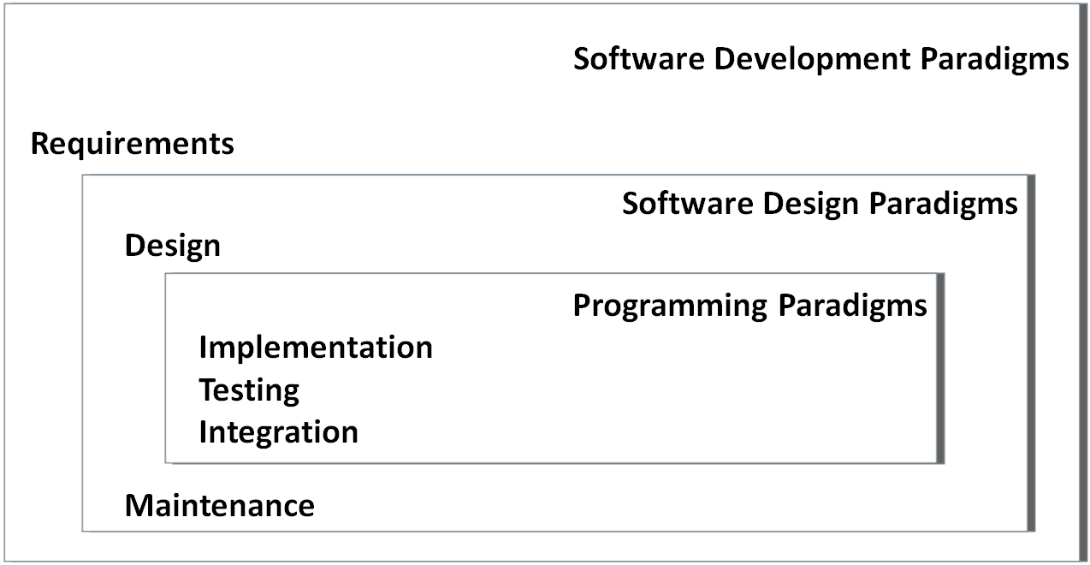
Software paradigms
Paradigm (a Greek word meaning example) is commonly used to refer to a category of entities that share a common characteristic.
Computer science distinguish three different kinds of software paradigms:
Programming Paradigm:
It is a model of how programmers communicate an calculation to computers
Software Design Paradigm:
It is a model for implementing a group of applications sharing common properties
Software Development Paradigm:
It is often referred to as Software Engineering, may be seen as a management model for implementing big software projects using engineering principles.

Slide 25
Programming paradigm
Programming paradigm is a fundamental style of computer programming.
Compare with a software development methodology, which is a style of solving specific software engineering problems.
Programming paradigm is a model for a class of programming languages that share a set of common characteristics.
Some languages are designed to support one particular paradigm
Smalltalk supports object-oriented programming
Haskell supports functional programming
Other programming languages support multiple paradigms
Object Pascal, C++, C#, Visual Basic, Common Lisp, Scheme, Perl, Python, Ruby, Oz and F#.

Slide 26
Programming paradigms
Different methodologies are more suitable for solving certain kinds of problems or applications domains.
Same for programming languages and paradigms.
Multiparadigm languages allow programmers to use the best tool for a job, admitting that no one paradigm solves all problems in the easiest or most efficient way.
Programming paradigms differ in:
the concepts and the abstractions used to represent the elements of a program (such as objects, functions, variables, constraints, etc.)
the steps that compose a computation (assignation, evaluation, data flow, control flow, etc.).

Slide 27
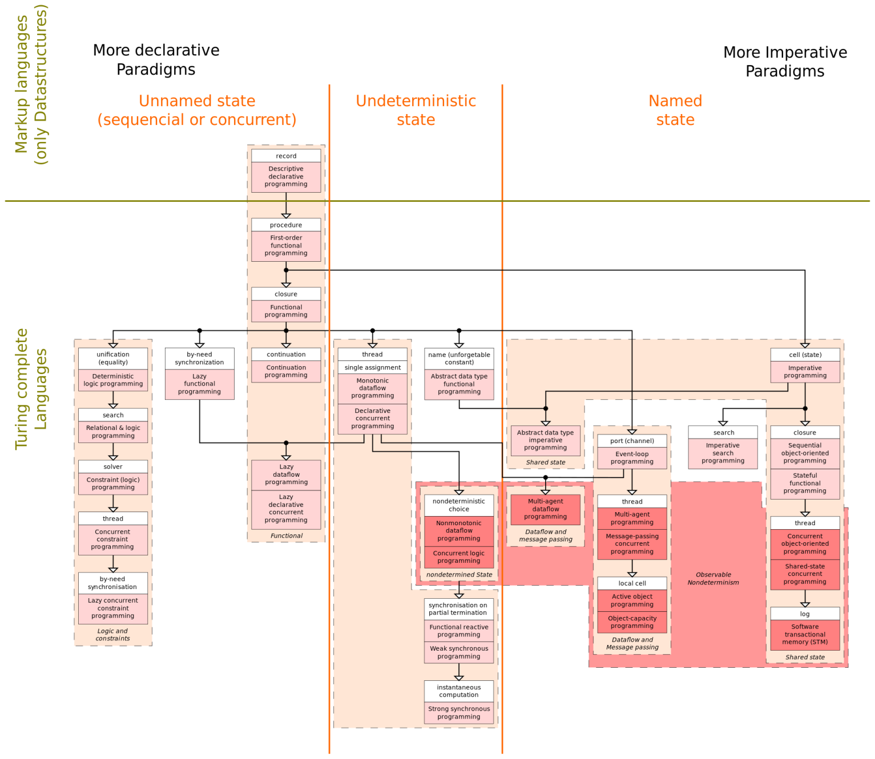
Programming paradigms
There are just four major programming language paradigms:
Imperative (Procedural) Paradigm
Object-Oriented (OO) Paradigm
Logic Paradigm
Functional Paradigm
Examples:
Imperative paradigm: Algol, Pascal, C, Ada;
Functional paradigm: Lisp, Refal, Planner, Scheme;
Logic paradigm: Prolog;
Object-oriented paradigm: Smalltalk, Eiffel.
Markup - new major paradigm
not a programming, but used to specify the layout of information in Web documents
Examples: XHTML, XML
Paradigm | Key concept | Program | Program execution | Result
Imperative | Command (instruction) | Sequence of commands | Execution of commands | Final state of computer memory
Functional | Function | Collection of functions | Evaluation of functions | Value of the main function
Logic | Predicate | Logic formulas: axioms and a theorem | Logic proving of the theorem | Failure or Success of proving
Object-oriented | Object | Collection of classes of objects | Exchange of messages between the objects | Final state of the objects’ states

Slide 28
Programming paradigms
Imperative
Von Neumann - Fortran, Pascal, Basic, C
Scripting - Perl, Python, JavaScript, PHP
Object-oriented - Smalltalk, Eiffel, C++
Declarative
Functional - Scheme, ML, pure Lisp, FP
Logic, constraint-based - Prolog, VisiCalc, RPG

Slide 29
Programming paradigms: Alternatives
Imperative
Procedural - C
Block-Structured - Pascal, Ada
Object-based - Ada
Object-oriented - Object-Pascal, C++, Java
Parallel Processing - Ada, Pascal-S, Occam, C-Linda
Declarative
Logic - Prolog
Functional - LISP, Scheme
Database - SQL

Slide 30
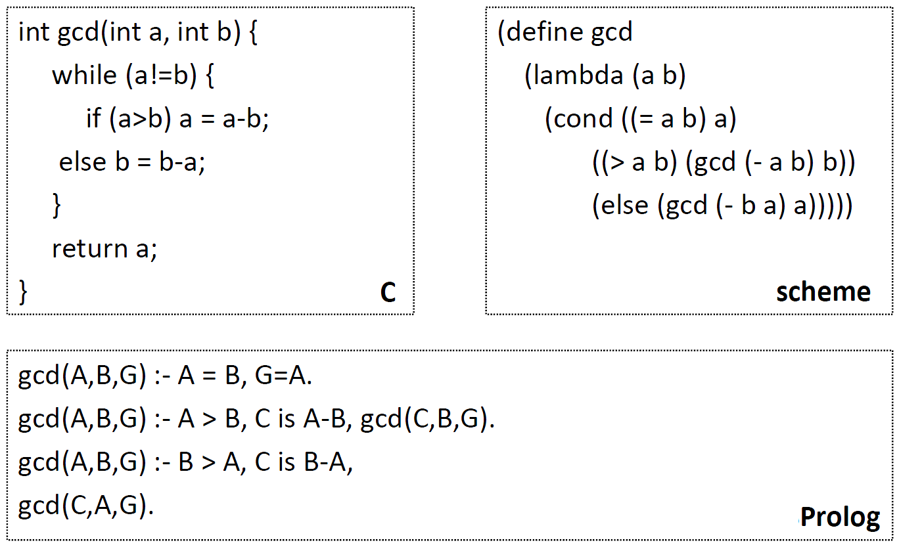
Programming paradigms
Examples

Slide 31
Programming paradigm
Examples of multiparadigm languages:
Imperative + OO paradigms: C++, Object Pascal, Ada-95, Java;
Functional + OO paradigms: Clos;
Logic + OO paradigms: Object Prolog.
Imperative + OO + Functional paradigms: Common Lisp.
Generally, a selected programming paradigm defines main property of a software developed by means of a programming language supporting the paradigm.
scalability/modifiability
integrability/reusability
portability
performance
reliability
ease of creation

Slide 32
Programming languages
A programming language is a system of signs used to communicate a task/algorithm to a computer, causing the task to be performed.
Most computer languages are designed to facilitate certain operations and not others: numerical computation, or text manipulation, or I/O.
At the heart it all is a fundamental question:
What does it mean to understand a programming language?
What do we need to know to program in a language?
There are three crucial components to any language.
Language paradigm
Syntax
Semantics

Slide 33
Programming languages
The language paradigm is a general principles that are used by a programmer to communicate a task/algorithm to a computer.
The syntax of the language is a way of specifying what is legal in the phrase structure of the language.
Knowing the syntax is analogous to knowing how to spell and form sentences in a natural language like English.
However, this doesn’t tell us anything about what the sentences mean.
The semantics of a program in that language is the third component.
Ultimately, without a semantics, a programming language is just a collection of meaningless phrases;
Hence, the semantics is the crucial part of a language.

Slide 34
Brief history: Machine language
Machine language – the sequence of bits that directly controls a processor
Add, compare, move data from one place to another, and so forth at appropriate times.
Example: program in machine language for the x86 (Pentium) instruction set, expressed as hexadecimal numbers.

Slide 35
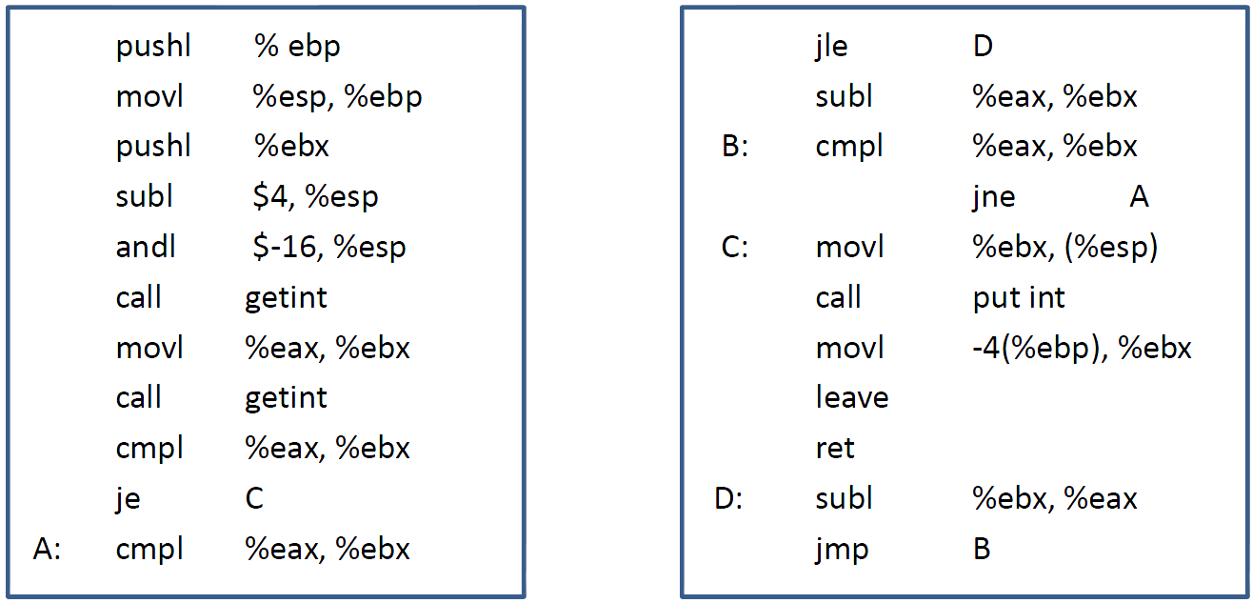
Brief history: Assembly language
Assembly language – expressed with mnemonic abbreviations, a less error-prone notation.
One-to-one correspondence between mnemonics and machine language instructions
Assembler – system program for translating from mnemonics to machine language
Machine-dependent language – rewrite programs for every new machine
Difficult to read and write large programs
Example: program in assembly language for the x86

Slide 36
Brief history: High-level languages
Fortran – first high-level language in the mid-1950s
Machine-independent language
Compiler – system program for translating from high-level language to assembly or machine language
Not one-to-one correspondence between source and target operations.
Other languages:
Algol 60, COBOL (1959), PL/1 (1964), C (1959-1963), Pascal (1968-1969)
LISP (1958), ML (1973)
Prolog (1970)
Smalltalk (1969-1972), C++ (1983), Java (1995)
Modula 2(1978), Ada (1980)

Slide 37
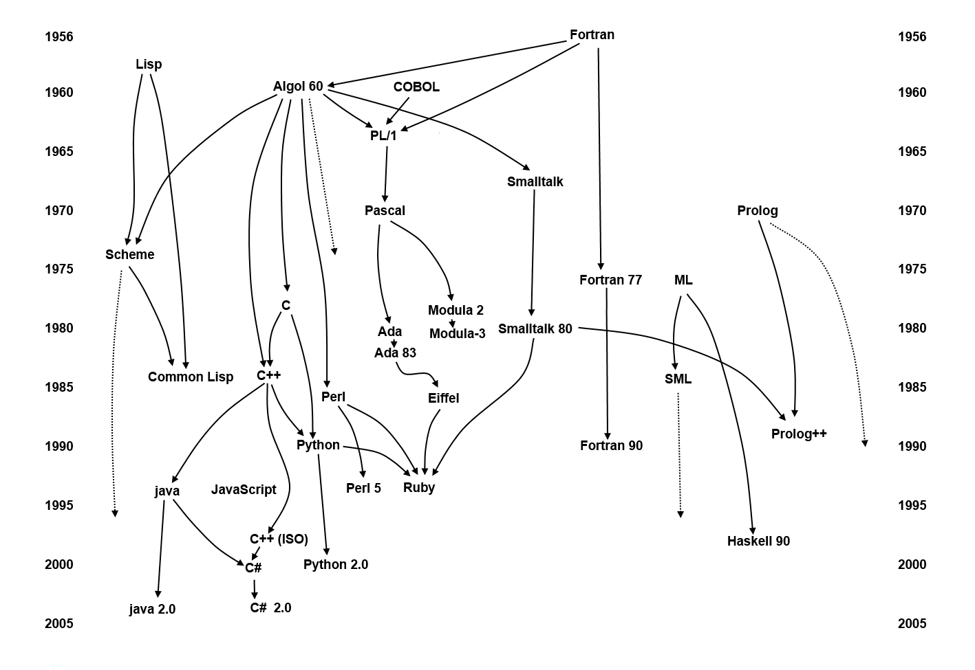
Brief history: High-level languages
Milestones

Slide 38
Why are there so many?
Evolution - learn better ways of doing things over time
‘goto’-based control flow (Fortran)
structured programming (Pascal, C)
object-oriented structure (C++, Java)
Special purpose
symbolic data
character strings
low-level system programming
reasoning, logical relation
Socio-economic factors:
proprietary interests
commercial advantage
Personal preference : diverse ideas about what is pleasant to use
Special hardware

Slide 39
Which programming language?
Since a task can be solved in different ways (paradigms), the language used to describe the solution differs in abstractions, structures due to the way in which the problem is solved.
Choose among alternative ways to express things
understand implementation costs
based on knowledge of what will be done underneath
Simulate useful features in languages that lack them.
There is no theory that dictates the best paradigm to solve a particular problem.
How choose programming language?
C vs. Modula-3 vs. C++ for systems programming
Fortran vs. APL vs. Ada for numerical computations
Ada vs. Modula-2 for embedded systems
Common Lisp vs. Scheme vs. ML for symbolic data manipulation
Java vs. C/CORBA for networked PC programs

Slide 40
What makes a language successful?
Expressive power
Easy to express things, to use once fluent (C, APL, Algol-68, Perl)
Ease of use for novice
Easy to learn (BASIC, Pascal, LOGO)
Ease of implementation
BASIC, Forth
Standardization
C, Java
Open source
Wide dissemination without cost (Pascal, Java)
Excellent compilers
Possible to compile to very good (fast/small) code (Fortran)
Patronage
Backing of a powerful sponsor (COBOL, PL/1, Ada, Visual Basic)

Slide 41
Language evaluation criteria
Major criteria
Readability: the ease with which programs can be read and understood
Writability: the ease with which a language can be used to create programs
Reliability: conformance to specifications (i.e., performs to its specifications under all conditions)
Others
Cost: the ultimate total cost
Portability: the ease with which programs can be moved from one implementation to another
Generality: the applicability to a wide range of applications
Well-definedness: the completeness and precision of the language’s official definition

Slide 42
Evaluation criteria: Readability
Overall simplicity
A manageable set of features and constructs
Few feature multiplicity (means of doing the same operation)
Minimal operator overloading
Orthogonality
A relatively small set of primitive constructs can be combined in a relatively small number of ways
Every possible combination is legal
Lack of orthogonality leads to exceptions to rules
Makes the language easy to learn and read
Meaning is context independent

Slide 43
Evaluation criteria: Readability
Control statements
The presence of well-known control structures (e.g., while statement)
Data types and structures
The presence of adequate facilities for defining data structures
Syntax considerations
Identifier forms: flexible composition
Special words and methods of forming compound statements
Form and meaning: self- descriptive constructs, meaningful keywords

Slide 44
Evaluation criteria: Writability
Simplicity and orthogonality
Few constructs, a small number of primitives, a small set of rules for combining them
Support for abstraction
The ability to define and use complex structures or operations in ways that allow details to be ignored
Expressivity
A set of relatively convenient ways of specifying operations
Example: the inclusion of for statement in many modern languages

Slide 45
Evaluation criteria: Reliability
Type checking
Testing for type errors
Exception handling
Intercept run-time errors and take corrective measures
Aliasing
Presence of two or more distinct referencing methods for the same memory location
Readability and writability
A language that does not support “natural” ways of expressing an algorithm will necessarily use “unnatural” approaches, and hence reduced reliability

Slide 46
Evaluation criteria: Cost
Training programmers to use language
Writing programs
Compiling programs
Executing programs
Language implementation system: availability of free compilers
Reliability: poor reliability leads to high costs
Maintaining programs

Slide 47
Programming domains
Scientific applications
Large number of floating point computations
Language: Fortran
Business applications
Produce reports, use decimal numbers and characters
Language: COBOL
Artificial intelligence
Symbols rather than numbers manipulated
Language: LISP
Systems programming
Need efficiency because of continuous use
Language: C
Web Programming
Eclectic collection of languages: markup (e.g., XHTML), scripting (e.g., PHP), general-purpose (e.g., Java)

Slide 48
Abstraction and Modularization
Re-use, sharing, extension of code are critically important in software engineering
Big idea: detect errors at compile-time, not when program is executed
Type definitions and declarations
Define intent for both functions/procedures and data
Abstract data types (ADT)
Access to local data only via a well-defined interface
Lexical scope

Slide 49
Static vs. Dynamic Typing
Static typing
Common in compiled languages, considered “safer”
Type of each variable determined at compile-time
Constrains the set of values it can hold at run-time
Dynamic typing
Common in interpreted languages
Types are associated with a variable at run-time; may change dynamically to conform to the type of the value currently referenced by the variable
Type errors not detected until a piece of code is executed

Slide 50
Implementation methods
Compilation
Programs are translated into machine language (e.g., Fortran, C, C++)
Better performance
Pure Interpretation
Programs are interpreted by another program known as an interpreter (e.g., Scheme, Haskell, Python …)
Greater flexibility
Better diagnostics (error messages)
Byte-code compiler
Produces portable bytecode, which is executed on virtual machine (e.g., Java)

Slide 51
Implementation methods
Mixed (Hybrid) approaches
Source-to-source translation (early C++ → C→compile)
Just-in-time Java compilers convert bytecode into native machine code when first executed

Slide 52
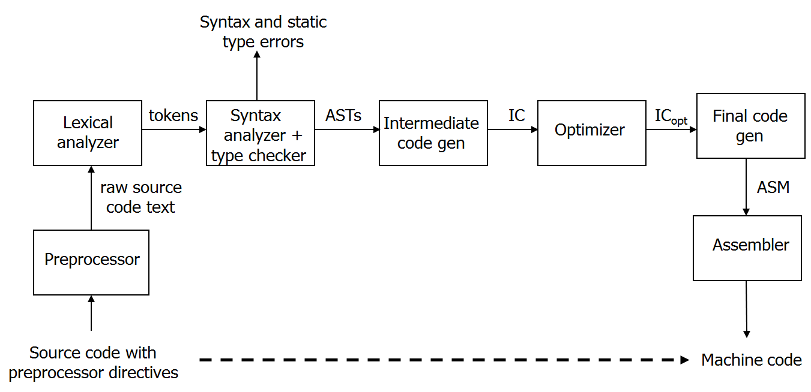
Compiler
Program that translates a source language into a target language
Target language is often, but not always, the assembly language for a particular machine
Compilation process
Notes:
Preprocessing: conditional macro text substitution
Lexical analysis: convert keywords, identifiers, constants into a sequence of tokens
Syntactic analysis: check that token sequence is syntactically correct
Generate abstract syntax trees (AST), check types
Intermediate code generation: “walk” the ASTs and generate intermediate code
Apply optimizations to produce efficient code
Final code generation: produce machine code

Slide 53
Checks during compilation
Syntactically invalid constructs
Invalid type conversions
A value is used in the “wrong” context, e.g., assigning a float to an int
Static determination of type information is also used to generate more efficient code
Know what kind of values will be stored in a given memory region during program execution
Some programmer logic errors
Can be subtle: if (a = b) … instead of if (a == b) …

Slide 54
Interpretation
‘Read-eval-print’ loop
Read in an expression, translate into internal form
Evaluate internal form
This requires an abstract machine and a “run-time” component (usually a compiled program that runs on the native machine)
Print the result of evaluation
Loop back to read the next expression
input expression
REPL interpreter
result
Interpreter
runtime

Slide 55
Bytecode compilation
Combine compilation with interpretation
Idea: remove inefficiencies of ‘read-eval-print’ loop
Bytecodes are conceptually similar to real machine opcodes, but they represent compiled instructions to a virtual machine instead of a real machine
Source code statically compiled into a set of bytecodes
Bytecode interpreter implements the virtual machine
Bytecode compiler
Bytecode interpreter
result
source
program
bytecodes
Virtual machine
runtime
Notes:
In what way are bytecodes “better” then real opcodes?

Slide 56
Questions ?

