Slide 1
Software Patterns
Lecturer: Assoc. Prof. Daniela Gotseva
http://dgotseva.com

Slide 2
What is a Pattern?
Current use comes from the work of the architect Christopher Alexander
Alexander studied ways to improve the process of designing buildings and urban areas
“Each pattern is a three-part rule, which expresses a relation between a certain context, a problem and a solution.”
Hence, the common definition of a pattern: “A solution to a problem in a context.”
Patterns can be applied to many different areas of human endeavor, including software development

Slide 3
Why Patterns?
"Designing object-oriented software is hard and designing reusable object-oriented software is even harder." - Erich Gamma
Experienced designers reuse solutions that have worked in the past
Well-structured object-oriented systems have recurring patterns of classes and objects
Knowledge of the patterns that have worked in the past allows a designer to be more productive and the resulting designs to be more flexible and reusable

Slide 4
Software Patterns History
1987 - Cunningham and Beck used Alexander’s ideas to develop a small pattern language for Smalltalk
1990 - The Gang of Four (Gamma, Helm, Johnson and Vlissides) begin work compiling a catalog of design patterns
1991 - Bruce Anderson gives first Patterns Workshop at OOPSLA
1993 - Kent Beck and Grady Booch sponsor the first meeting of what is now known as the Hillside Group
1994 - First Pattern Languages of Programs (PLoP) conference
1995 - The Gang of Four (GoF) publish the Design Patterns book

Slide 5
Types of Software Patterns
Analysis
Design
Organizational
Process
Project Planning
Configuration Management

Slide 6
Types of Software Patterns
Riehle and Zullighoven in “Understanding and Using Patterns in Software Development” mention three types of software patterns
Conceptual Pattern
Pattern whose form is described by means of terms and concepts from the application domain
Design Pattern
Pattern whose form is described by means of software design constructs, such as objects, classes, inheritance and aggregation
Programming Pattern (Programming Idiom)
Pattern whose form is described by means of programming language constructs

Slide 7
Design Pattern: Level of Abstraction
Complex design for an entire application or subsystem
Solution to a general design problem in a particular context
Simple reusable design class such as a linked list, hash table, etc.

Slide 8
GoF Design Patterns
The GoF design patterns are in the middle of these levels of abstraction
“A design pattern names, abstracts, and identifies key aspects of a common design structure that makes it useful for creating a reusable object-oriented design.”
The GoF design patterns are “descriptions of communicating objects and classes that are customized to solve a general design problem in a particular context.”

Slide 9
GoF Classification of Design Patterns
Purpose - what a pattern does
Creational Patterns
Concern the process of object creation
Structural Patterns
Deal with the composition of classes and objects
Behavioral Patterns
Deal with the interaction of classes and objects
Scope - what the pattern applies to
Class Patterns
Focus on the relationships between classes and their subclasses
Involve inheritance reuse
Object Patterns
Focus on the relationships between objects
Involve composition reuse

Slide 10
GoF Essential Elements of Design Patterns
Pattern Name
Having a concise, meaningful name for a pattern improves communication among developers
Problem
What is the problem and context where we would use this pattern?
What are the conditions that must be met before this pattern should be used?
Solution
A description of the elements that make up the design pattern
Emphasizes their relationships, responsibilities and collaborations
Not a concrete design or implementation; rather an abstract description
Consequences
The pros and cons of using the pattern
Includes impacts on reusability, portability, extensibility

Slide 11
GoF Pattern Template
Pattern Name and Classification
A good , concise name for the pattern and the pattern's type
Intent
Short statement about what the pattern does
Also Known As
Other names for the pattern
Motivation
A scenario that illustrates where the pattern would be useful
Applicability
Situations where the pattern can be used

Slide 12
GoF Pattern Template
Structure
A graphical representation of the pattern
Participants
The classes and objects participating in the pattern
Collaborations
How to do the participants interact to carry out their responsibilities?
Consequences
What are the pros and cons of using the pattern?
Implementation
Hints and techniques for implementing the pattern

Slide 13
GoF Pattern Template
Sample Code
Code fragments for a sample implementation
Known Uses
Examples of the pattern in real systems
Related Patterns
Other patterns that are closely related to the pattern

Slide 14
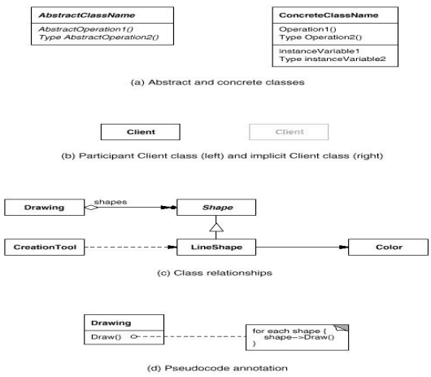
GoF Notation
The GoF book uses the Object Modeling Technique (OMT) notation for class and object diagrams:

Slide 15
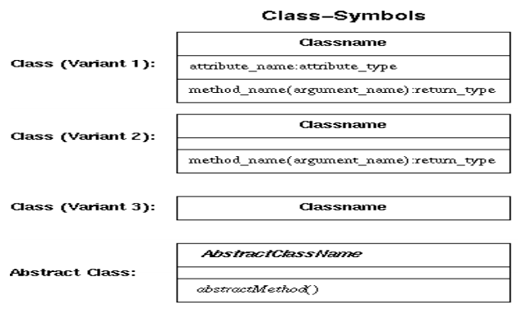
UML Notation

Slide 16
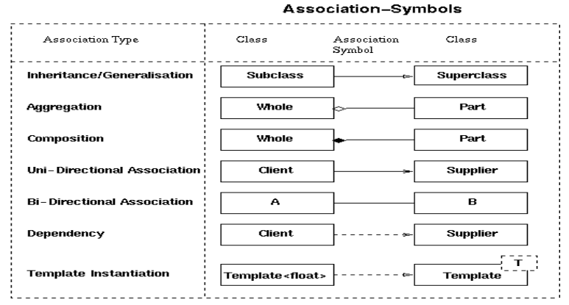
UML Notation

Slide 17
Benefits of Design Pattern
Capture expertise and make it accessible to non-experts in a standard form
Facilitate communication among developers by providing a common language
Make it easier to reuse successful designs and avoid alternatives that diminish reusability
Facilitate design modifications
Improve design documentation
Improve design understandability

Slide 18
Course Topics
Basic Programming constructs
Procedural programming: types, structured control.
OOP: Classes, inheritance, and interfaces.
Exception handling
Design Patterns
The Observer Pattern
The Template Method Pattern
Factory Patterns: Factory Method and Abstract Factory
The Singleton Pattern
The Iterator Pattern
The Composite Pattern
The Facade Pattern
The State and Strategy Patterns

Slide 19
Course Topics
Functors and the Command Pattern
The Adapter Pattern
The Proxy Pattern
RMI
The Decorator Pattern
Dynamic Proxies In Java
The Chain of Responsibility Pattern
The Visitor Pattern

Slide 20
Literature
Core Java™ 2: Volume I–Fundamentals (CJv1)
Core Java™ 2: Volume II–Advanced Features (CJv2)
Thinking in Java
Design Patterns: Elements of Reusable Object-Oriented Software, Gamma, Helm, Johnson and Vlissides, Addison-Wesley, 1995
Design Patterns for Object-Oriented Software Development, Wolfgang Pree, Addison-Wesley/ACM Press, 1995
Patterns of Software: Tales From The Software Community, Richard P. Gabriel, Oxford University Press, 1996
Pattern Oriented Software Architecture : A System of Patterns, Frank Buschmann (Editor), Wiley, 1996

Slide 21
Literature
Analysis Patterns: Reusable Object Models, Martin Fowler, Addison-Wesley, 1997
Pattern Hatching: Design Patterns Applied, John Vlissides, Addison-Wesley, 1998
Patterns in Java Volume 1, Mark Grand, Wiley, 2nd Ed., 2002
Patterns in Java Volume 2, Mark Grand, Wiley, 1999
Java Enterprise Design Patterns: Patterns in Java Volume 3, Mark Grand, Wiley, 2001
The Patterns Handbook, edited by Linda Rising, Cambridge University Press, 1998
Java Design Patterns - A Tutorial, James W. Cooper, AddisonWesley, 2000

Slide 22
Literature
Design Patterns Explained, Alan Shalloway and James R. Trott, Addison-Wesley, 2001
Core J2EE Patterns: Best Practices and Design Strategies, Alur, Crupi and Malks, 2001
Design Patterns Java Workbook, Steven John Metsker, AddisonWesley, 2002
Applied Java Patterns, Stephen Stelting and Olav Maassen, Prentice Hall, 2002
EJB Design Patterns: Advanced Patterns, Processes, and Idioms, Floyd Marinescu, Wiley, 2002

Slide 23
Literature
Patterns Of Enterprise Application Archictecture, Martin Fowler, Addison-Wesley, 2002
Head First Design Patterns, Freeman and Freeman, O'Reilly, 2004
Core Security Patterns - Best Practices and Strategies for J2EE(TM), Web Services, and Identity Management, Christopher Steel, Ramesh Nagappan and Ray Lai, Prentice Hall, 2005
Refactoring To Patterns, Joshua Kerievsky, Addison-Wesley, 2005

Slide 24
Introduction in Java
Lecture No 1 - 3
(CJv1, chapters 1-3)

Slide 25
About OOP
Latest in a long line of programming styles or fads, from structured programming, modular programming, abstract data types, OOP.
These appear periodically like diet fabs or self-help fabs. Each new system promises to revolutionize programming, eliminate bugs, ensure projects finish under busget and on-time, and guarantee thin thighs in 30 days.
OOP has been the methodology-du-jour for some time now and there is little evidence things have radically changed.
New methodologies are constantly appearing, design patterns, Anti-Patterns, Extreme Programming (best name I think).

Slide 26
Java
Java is an Object-Oriented language developed by Sun Microsystems.
In it's short history it has been re-marketed several times. Originally designed as a language for programming computing appliances, it was re-targeted around applets in the early days of the Web.
The advantage of Java for this task lay in it's platform independence.
As applets failed to gain widespread traction, Java was re-marketed as a replacement for C++ in enterprise software development.
It's features being it's simplified semantics, memory management, and again portability. It has made some small inroads in this area but far from dominant (or even significant). Currently, the most action in the Java world seems to be around server-side Web programming.

Slide 27
Java
Despite its currently limited role in the application development space, Java is a good language for learning OOP.
It is considerably less complex than C++, yet keeps low-level details (such as memory management) from being distracting.
The main danger of Java is that one gets too used to things being easy and hidden and become unable to function in a less supportive and protective environment.
One more note: Although Java is usually thought of as a language. It is really 3 things: a language, a set of libaries,and a run-time environment that supports the language and iteracts with the actual underlying platform (UNIX, Windows, etc). You will see this, for example,in the way Java maps classes to files and class names to file paths.

Slide 28
Hello world

Slide 29
Features of Codding
Java permits only one public class per file.
If the class has name Hello, then the file MUST has the same name: Hello.java
To compile the code without environment: javac Hello.java
To start the compiled code: java Hello

Slide 30
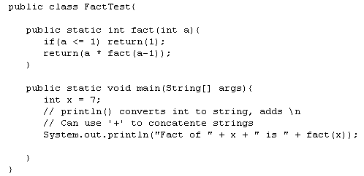
Factoriel

Slide 31
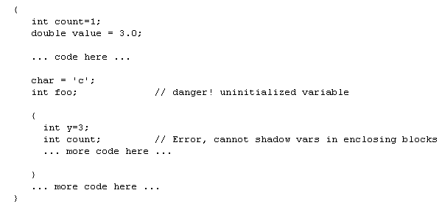
Variables

Slide 32
Syntax
statements are terminated with ;
{} are used to delimit blocks (compound statements)
// used for end-of-line comments. C /* ... */ syntax also allowed
variables must be defined before use.
variables can be defined anywhere in block.
unlike C which required definitions at top.
variables can be initialized with '='
variables don't have to be initialized, but they should be.
variables are defined with 'types'

Slide 33
Types
'types' specify partial information about a variable's value. Ex. we know it's an integer, not a character string, but we don't know which one.
Types are used by compiler to perform error checking on programs
Eg. Makes sure you don't multiply a number and a string.
Types also define size of storage to be allocated.
Java has a number of built-in basic types:
boolean - true or false
byte,short,int,long - 1,2,4,8 byte signed integers
note diffs with C/C++
float,double - 4 and 8 byte floating point numbers
char - character type (Unicode); not convertable to int
void - no type, used to type functions that don't return a value
Java also supports array types (more in recitation).
As well as basic types, Java supports Object types
object support lets programmings extend the type system and take advantage of the type checking (as well as other benefits).

Slide 34
Default Value Demo
defValue

Slide 35
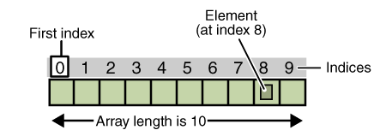
Arrays
The array contains fixed number elements from the same type.
The length of the array is obtained in the creation.
Not allow changing the length of the array one created.

Slide 36
Arrays
Working with the array goes through 3 stages:
Declaration
Memory allocation
Initialization of its elements

Slide 37
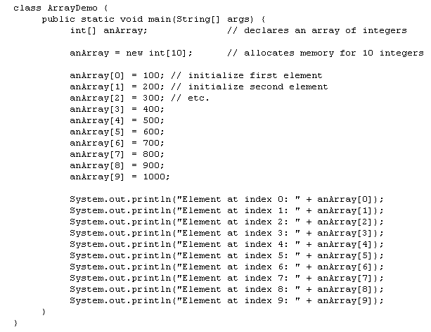
Arrays

Slide 38
Multidimensional Arrays
In Java multidimensional array is an array, which elements are arrays.
It’s allow creating ragged arrays – two dimensional arrays, each row has different number of elements.

Slide 39
Multidimensional Arrays Demo
ArrayOfArrays
raggedArrays

Slide 40
Array Copy Function
Java has a standard function for this purpose:

Slide 41
Variable Scoping
Variable are either local variables (local to some method) or instance/class variables. There are no global variables per-se in Java.
Local variables are allocated on the stack and scoped to the enclosing block. The extent of local variables is the local block. Note: The extent of a reference variable and the object it references are different!
Instance variables we discuss next lecture.

Slide 42
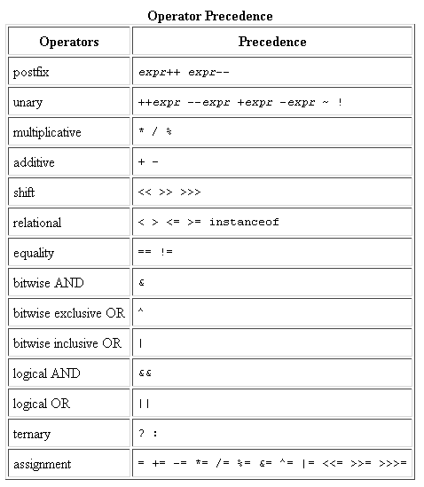
Expressions
combine variables and constants
expressions evaluate to (typed) value
expression syntax is infix operator syntax (ie normal math syntax).
>>>(unsigned shift) >>(signed shift)

Slide 43
Type conversion
Automatically converts integers -> float -> double as needed.
Ex. (2.4 * 2) -> 4.8 (a double)
Be care with conversion: rounding and overflow can cause errors.

Slide 44
Basic conditional
condition must evaluate to a boolean type
no fooling around as in C/C++
else clause is optional
if branch code is single statement, the {} are not required.
Be careful, if later a second statement is added only one will be considered inside the 'if'. Best to always use {}.
The 'else' associated with closest 'if' when ambiguous. Use delimiters to avoid ambiguity

Slide 45
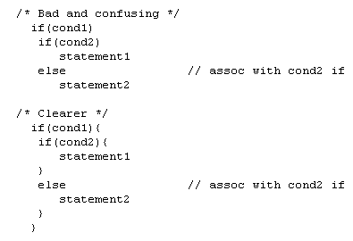
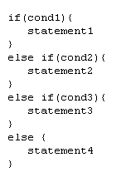
Basic conditional

Slide 46
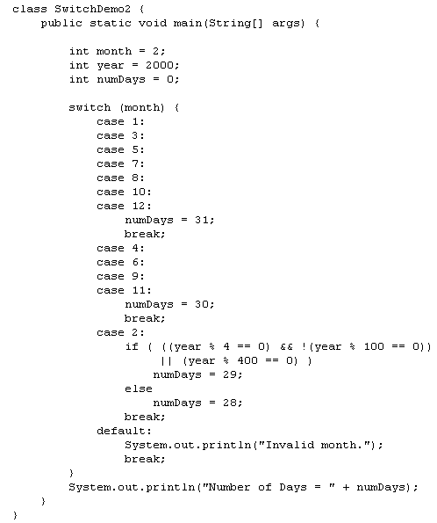
Statement switch
Works with:
byte, short, char и int primitive data types;
enumerated types;
Some special classes "wrap" of primitive types : Character, Byte, Short, and Integer

Slide 47
Loop statements
initialization and increment are statements
condition is an expression that evaluates to a boolean
Semantics
1) execute initialization
2) evaluate condition
3) if false, jump to code after loop
4) if true, execute loop code, then execute increment
5) goto 2)

Slide 48
Loop statements
continue and break statements provide fine control on loops
break -- leave loop immediately (goto code after loop)
continue -- stop executing loop code, jump to increment and condition test

Slide 49
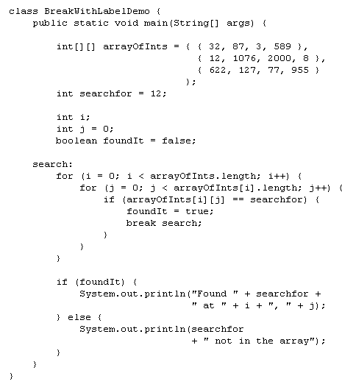
Break with Label
Execution is passed to the statement after labeled.

Slide 50
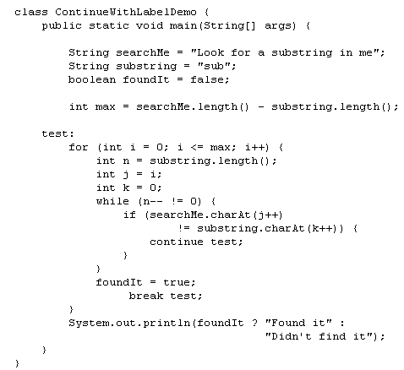
Continue with Label
Execution is passed to the loop with label.

Slide 51
Loop Statements common patterns: counting loop
executes N times (assuming no breaks or assignments to i)
i goes from 0 to N-1 in loop
i == N when loop terminates
numerical pgmrs like to start loops at 1, be careful to avoid fencepost errors.
Be consistant in your loops (eg, start from 0, count up).
Don't alter loop variable in loop code (too confusing)

Slide 52
Loop Statements common patterns: next loop
used to follow a chain of links data structures Ex. cdr'ing down a linked list.
probably 99% of all for loops you write will follow these patterns

Slide 53
Loop Statements
Enhanced loop for, used for reading data from array or collection
Use it whenever possible.

Slide 54
While loop
equivalent to for(;condition;){}
loop code (or external input), must affect 'condition' value (or else we loop forever).
semantics
1) evaluate condition
2) if false, exit loop
3) if true, execute loop code
4) goto 1)

Slide 55
Do-while Loop
semantics
1) execute loop code
2) evaluate condition
2) if false, exit loop
3) goto 1)

Slide 56
Functions
Java does not have global functions.
Static methods are semantically equivalent.
Argments and return values must be typed
Static keyword indicates global scope
public keyword indicates accessability
methods can be called from within defining class with method name

Slide 57
Functions
function names can be overloaded by types

Slide 58
Sorting Demo
sorting1

Slide 59
String Data Type
String is a built-ing data type representing character strings
String variable can use standard initialization syntax String s = "foo";
Java overloads the + operator to cover String concatenation "foo" + "bar" -> "foobar"
String variables are reference types String a = "foo"; String b = a; // a and b are 'eq', reference same object.

Slide 60
String Data Type
Unlike integer variables, and like array variables, Strings involve two units of memory, the String variable itself, and the storage referenced by the string variable (string of characters).
Stack vs heap storage
String's are an example of a built-in object type.
In addition to '+' operator, the string type supports several 'methods' For example, String s = "foo"; int len = s.length(); // length method return number of chars (3)

Slide 61
String Data Type
We saw static methods in the previous lecture, these are essentially global functions in the C sense.
The length() method of String is an 'instance' method. The means it has access to the data of a particular instance of the String on with it was invoked.
In general method call syntax is objectvar.methodname(args..);
There are also static methods of string. For example: String.valueOf(int i) -- returns String representation of i.
The general static method call syntax is ClassName.methodName(args...)
Instance methods are essentially function calls with one implicit argument: the object instance on which the method is called.

Slide 62
String Data Type
String ( and objects in general) are created by calling their 'constructor' routine with the operator 'new' String s = new String("foo");
Constructors have the name of the object type (the class). A class can have multiple constructors with different argument signatures.
Constructors are always called with 'new';

Slide 63
String Data Type
Unlike C++, Java has no destructors. Object instances are garbage collected when no longer references.

Slide 64
String Demo
Strings
Strings&references

Slide 65
Formatting Strings
This is analogue to C printf

Slide 66
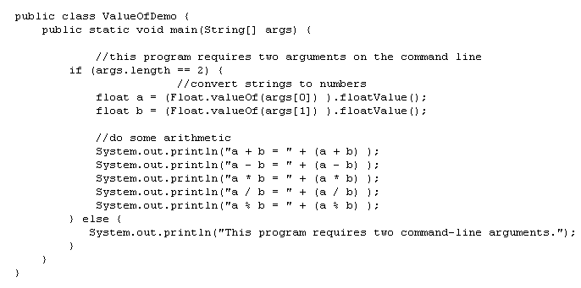
Converting Strings to Numbers
Used class wrapper of primitive data type. It has built-in function valueOf().

Slide 67
Converting Strings to Numbers
Another way is to use parseXXX() method, where XXX is concrete type. These are again functions of wrapper classes :

Slide 68
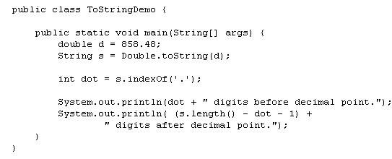
Converting Numbers to String
By concatenation
By String.valueOf()
By toString() method of the wrapper classes

Slide 69
String Manipulations
charAt(int i) – returns character at i-th position

Slide 70
String Manipulations
Method | Description
String substring(int begin, int end) | Returns substring from begin to end
String substring(int begin) | Returns substring from begin to the end of string

Slide 71
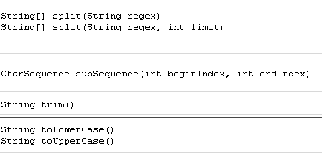
String Manipulations
CharSequence is interface, implemented by String class.

Slide 72
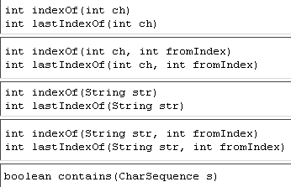
Searching characters and substring into string

Slide 73
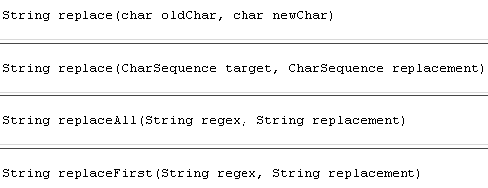
Replace characters and substring into string

Slide 74
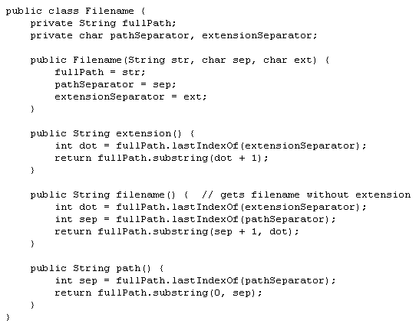
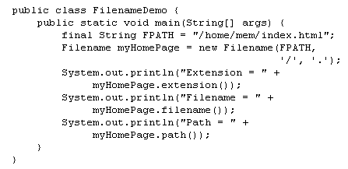
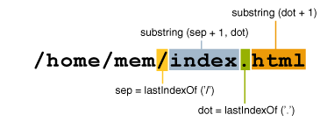
Example

Slide 75
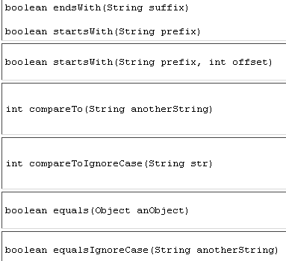
Comparison between strings

Slide 76
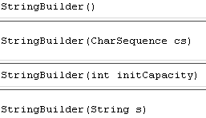
StringBuilder Class
StringBuilder different from String that its objects can be modified.
Creating StringBuilder objects is done by:

Slide 77
Length and Capacity of StringBuilder

Slide 78
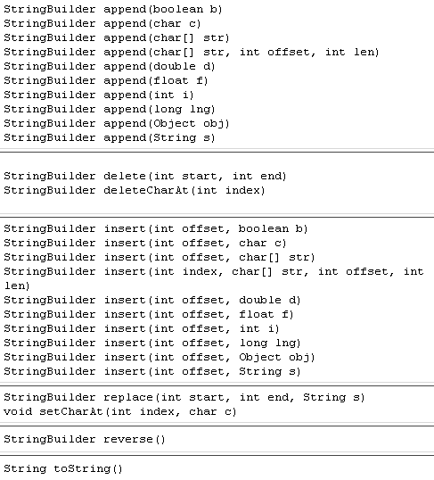
Methods of StringBuilder

Slide 79
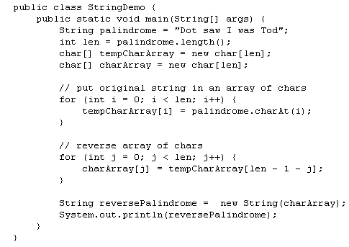
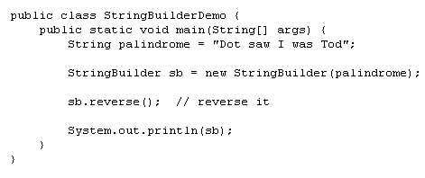
Example

Slide 80
Enum Types
enum type is type whose fields are a fixed set of constants.
Examples: compass directions (NORTH, SOUTH, EAST, and WEST) and days of week.

Slide 81
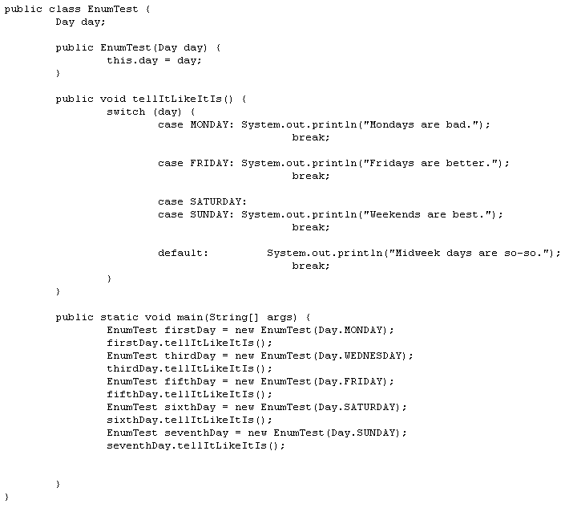
Enum Types

Slide 82
Enum Types
enum defines class (enum type).
The body of enum class may include methods and other fields. The compiler creates special methods automatically. For example, it creates static values method, which returns all values of the enum in order of declaration. Used to organize for-each loop.
All enums implicitly inherit java.lang.Enum and can’t inherit from another class!

Slide 83
Enum Types
Java constants required to define first, before any methods.
Constructor of the enum type must be package-private or private. It automatically creates constants.
Not allow enum constructor call obviously.

Slide 84
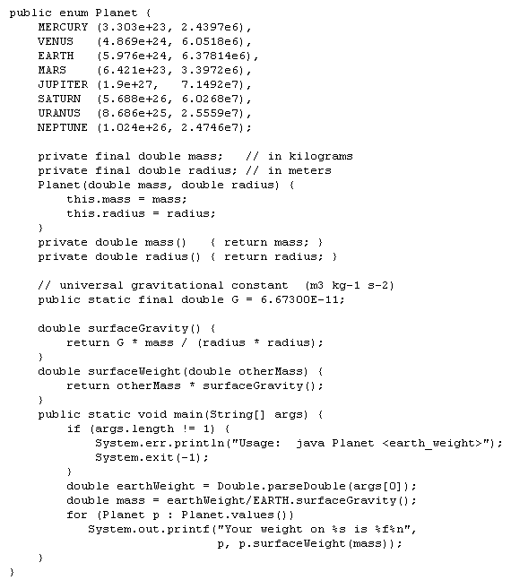
Enum Types

Slide 85
Enum Demo
EnumTest
Planet

Slide 86
Basic I/O From Keyboard/Screen

Slide 87
Scanning
Objects of type Scanner are useful for breaking down formatted input into tokens and translating individual tokens according to their data type.
Breaking Input into Tokens
By default, a scanner uses white space to separate tokens.
A simple text scanner which can parse primitive types and strings using regular expressions.A Scanner breaks its input into tokens using a delimiter pattern, which by default matches whitespace. The resulting tokens may then be converted into values of different types using the various next methods.
For example, this code allows a user to read a number from System.in:

Slide 88
Scanning
As another example, this code allows long types to be assigned from entries in a file myNumbers:
The scanner can also use delimiters other than whitespace. This example reads several items in from a string:

Slide 89
Scanning
The same output can be generated with this code, which uses a regular expression to parse all four tokens at once:
The default whitespace delimiter used by a scanner is as recognized by Character.isWhitespace. The reset() method will reset the value of the scanner's delimiter to the default whitespace delimiter regardless of whether it was previously changed.
A scanning operation may block waiting for input.

Slide 90
Scanning
The next() and hasNext() methods and their primitive-type companion methods (such as nextInt() and hasNextInt()) first skip any input that matches the delimiter pattern, and then attempt to return the next token. Both hasNext andnext methods may block waiting for further input. Whether a hasNext method blocks has no connection to whether or not its associated next method will block.
The findInLine(java.lang.String), findWithinHorizon(java.lang.String, int), and skip(java.util.regex.Pattern) methods operate independently of the delimiter pattern. These methods will attempt to match the specified pattern with no regard to delimiters in the input and thus can be used in special circumstances where delimiters are not relevant. These methods may block waiting for more input.

Slide 91
Scanning
When a scanner throws an InputMismatchException, the scanner will not pass the token that caused the exception, so that it may be retrieved or skipped via some other method.
Depending upon the type of delimiting pattern, empty tokens may be returned. For example, the pattern "\\s+" will return no empty tokens since it matches multiple instances of the delimiter. The delimiting pattern "\\s" could return empty tokens since it only passes one space at a time.

Slide 92
Scanning
A scanner can read text from any object which implements the Readable interface. If an invocation of the underlying readable's Readable.read(java.nio.CharBuffer) method throws an IOException then the scanner assumes that the end of the input has been reached. The most recent IOException thrown by the underlying readable can be retrieved via the ioException() method.
When a Scanner is closed, it will close its input source if the source implements the Closeable interface.
A Scanner is not safe for multithreaded use without external synchronization.
Unless otherwise mentioned, passing a null parameter into any method of a Scanner will cause a NullPointerException to be thrown.
A scanner will default to interpreting numbers as decimal unless a different radix has been set by using the useRadix(int) method. The reset() method will reset the value of the scanner's radix to 10 regardless of whether it was previously changed.

Slide 93
Basic I/O Demo
ScanSum
ScanXan

Slide 94
Formatting
Stream objects that implement formatting are instances of either PrintWriter, a character stream class, or PrintStream, a byte stream class.
The only PrintStream objects you are likely to need are System.out and System.err.
Like all byte and character stream objects, instances of PrintStream and PrintWriter implement a standard set of write methods for simple byte and character output. In addition, both PrintStream and PrintWriter implement the same set of methods for converting internal data into formatted output. Two levels of formatting are provided:
print and println format individual values in a standard way.
format formats almost any number of values based on a format string, with many options for precise formatting.

Slide 95
Formatting
Invoking print or println outputs a single value after converting the value using the appropriate toString method.
The format method formats multiple arguments based on a format string. The format string consists of static text embedded with format specifiers; except for the format specifiers, the format string is output unchanged.
Format strings support many features. In this tutorial, we'll just cover some basics.

Slide 96
Formatting
The three conversions used here are:
d formats an integer value as a decimal value.
f formats a floating point value as a decimal value.
n outputs a platform-specific line terminator.
Here are some other conversions:
x formats an integer as a hexadecimal value.
s formats any value as a string.
tB formats an integer as a locale-specific month name.

Slide 97
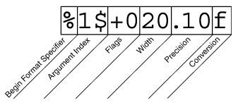
Formatting
The elements must appear in the order shown. Working from the right, the optional elements are:
Precision. For floating point values, this is the mathematical precision of the formatted value. For s and other general conversions, this is the maximum width of the formatted value; the value is right-truncated if necessary.
Width. The minimum width of the formatted value; the value is padded if necessary. By default the value is left-padded with blanks.
Flags specify additional formatting options. In the Format example, the + flag specifies that the number should always be formatted with a sign, and the 0 flag specifies that 0 is the padding character. Other flags include - (pad on the right) and , (format number with locale-specific thousands separators). Note that some flags cannot be used with certain other flags or with certain conversions.
The Argument Index allows you to explicitly match a designated argument. You can also specify < to match the same argument as the previous specifier. Thus the example could have said: System.out.format("%f, %<+020.10f %n", Math.PI);

Slide 98
Conversion | Argument Category | Description
'b', 'B' | general | If the argument arg is null, then the result is "false". If arg is a boolean or Boolean, then the result is the string returned by String.valueOf(arg). Otherwise, the result is "true".
'h', 'H' | general | If the argument arg is null, then the result is "null". Otherwise, the result is obtained by invoking Integer.toHexString(arg.hashCode()).
's', 'S' | general | If the argument arg is null, then the result is "null". If arg implements Formattable, then arg.formatTo is invoked. Otherwise, the result is obtained by invoking arg.toString().
'c', 'C' | character | The result is a Unicode character
'd' | integral | The result is formatted as a decimal integer
'o' | integral | The result is formatted as an octal integer
'x', 'X' | integral | The result is formatted as a hexadecimal integer
'e', 'E' | floating point | The result is formatted as a decimal number in computerized scientific notation
'f' | floating point | The result is formatted as a decimal number
'g', 'G' | floating point | The result is formatted using computerized scientific notation or decimal format, depending on the precision and the value after rounding.
'a', 'A' | floating point | The result is formatted as a hexadecimal floating-point number with a significand and an exponent
't', 'T' | date/time | Prefix for date and time conversion characters.
'%' | percent | The result is a literal '%' ('\u0025')
'n' | line separator | The result is the platform-specific line separator

Slide 99
Basic I/O Demo
Root
Root2

